Slide 1
Capitol Hill Alphabet Animal Art Project
Virtual Sculpture Tour!

Slide 2
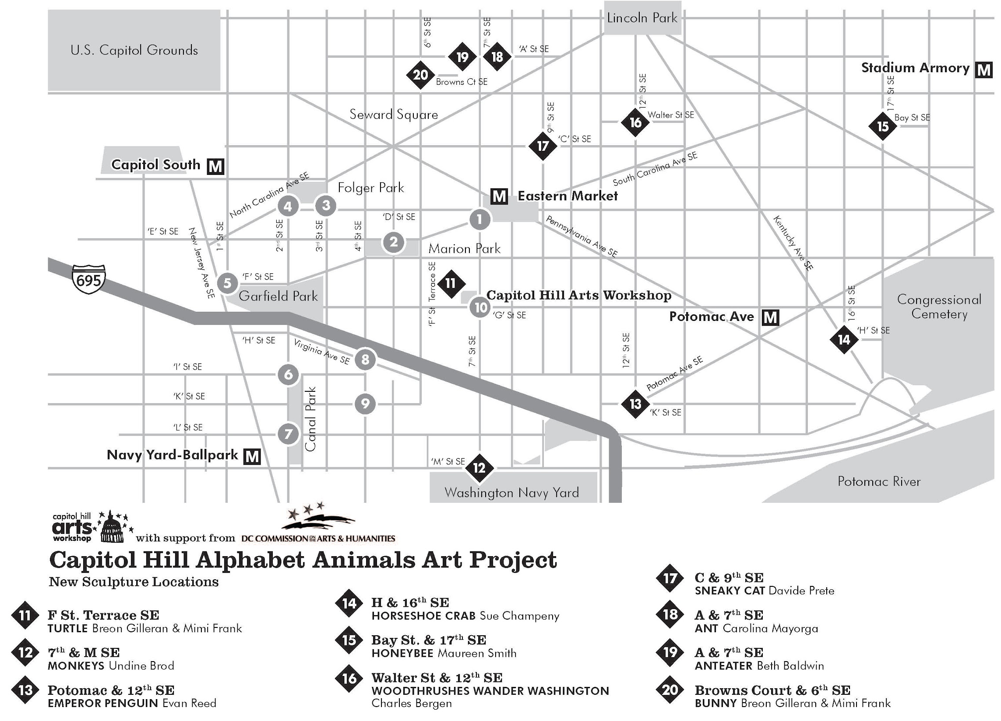
Notes:
The Alphabet Animals are based in ANC6B, which is located in the SE quadrant of DC. You can see that between the last iteration of the project and this one, we span five metro stations! Cap South to the West, Navy Yard to the South, Past Potomac Ave. to the East (all the way to Congressional Cemetery, in fact), Stadium Armory to the North, and quite a few clustered above Eastern Market.
As in the last iteration of the project, one of the major goals is to improve walkability--making the neighborhood more livable for residents and more vibrant for all. The selection of the new locations intentionally broadens the span of the Alphabet Animal “path” to continue to connect disparate parts of the neighborhood through their shared animal sculptures. This neighborhood combines the proximity to national landmarks with DC’s largest residential historic district, and is also one of the oldest neighborhoods (Source: Compass Realtors, https://www.compass.com/neighborhood-guides/dc/capitol-hill/ ). It is also a neighborhood that has seen enormous change over the past several decades. The Alphabet Animals are by nature inclusive and accessible, and especially now...a great outdoor activity.

Slide 3
THE BEGINNING: 2011-2014
Notes:
But before we dive into the sculpture walk, I want to go back in time a little bit (I think adding a time machine is the next new zoom feature!)

Slide 4
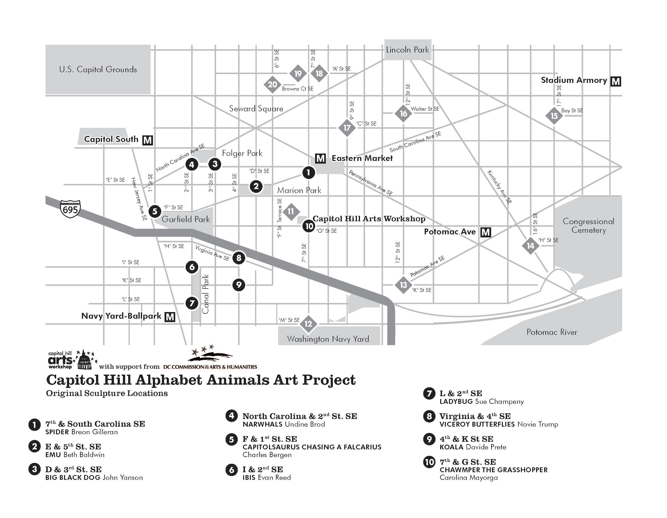
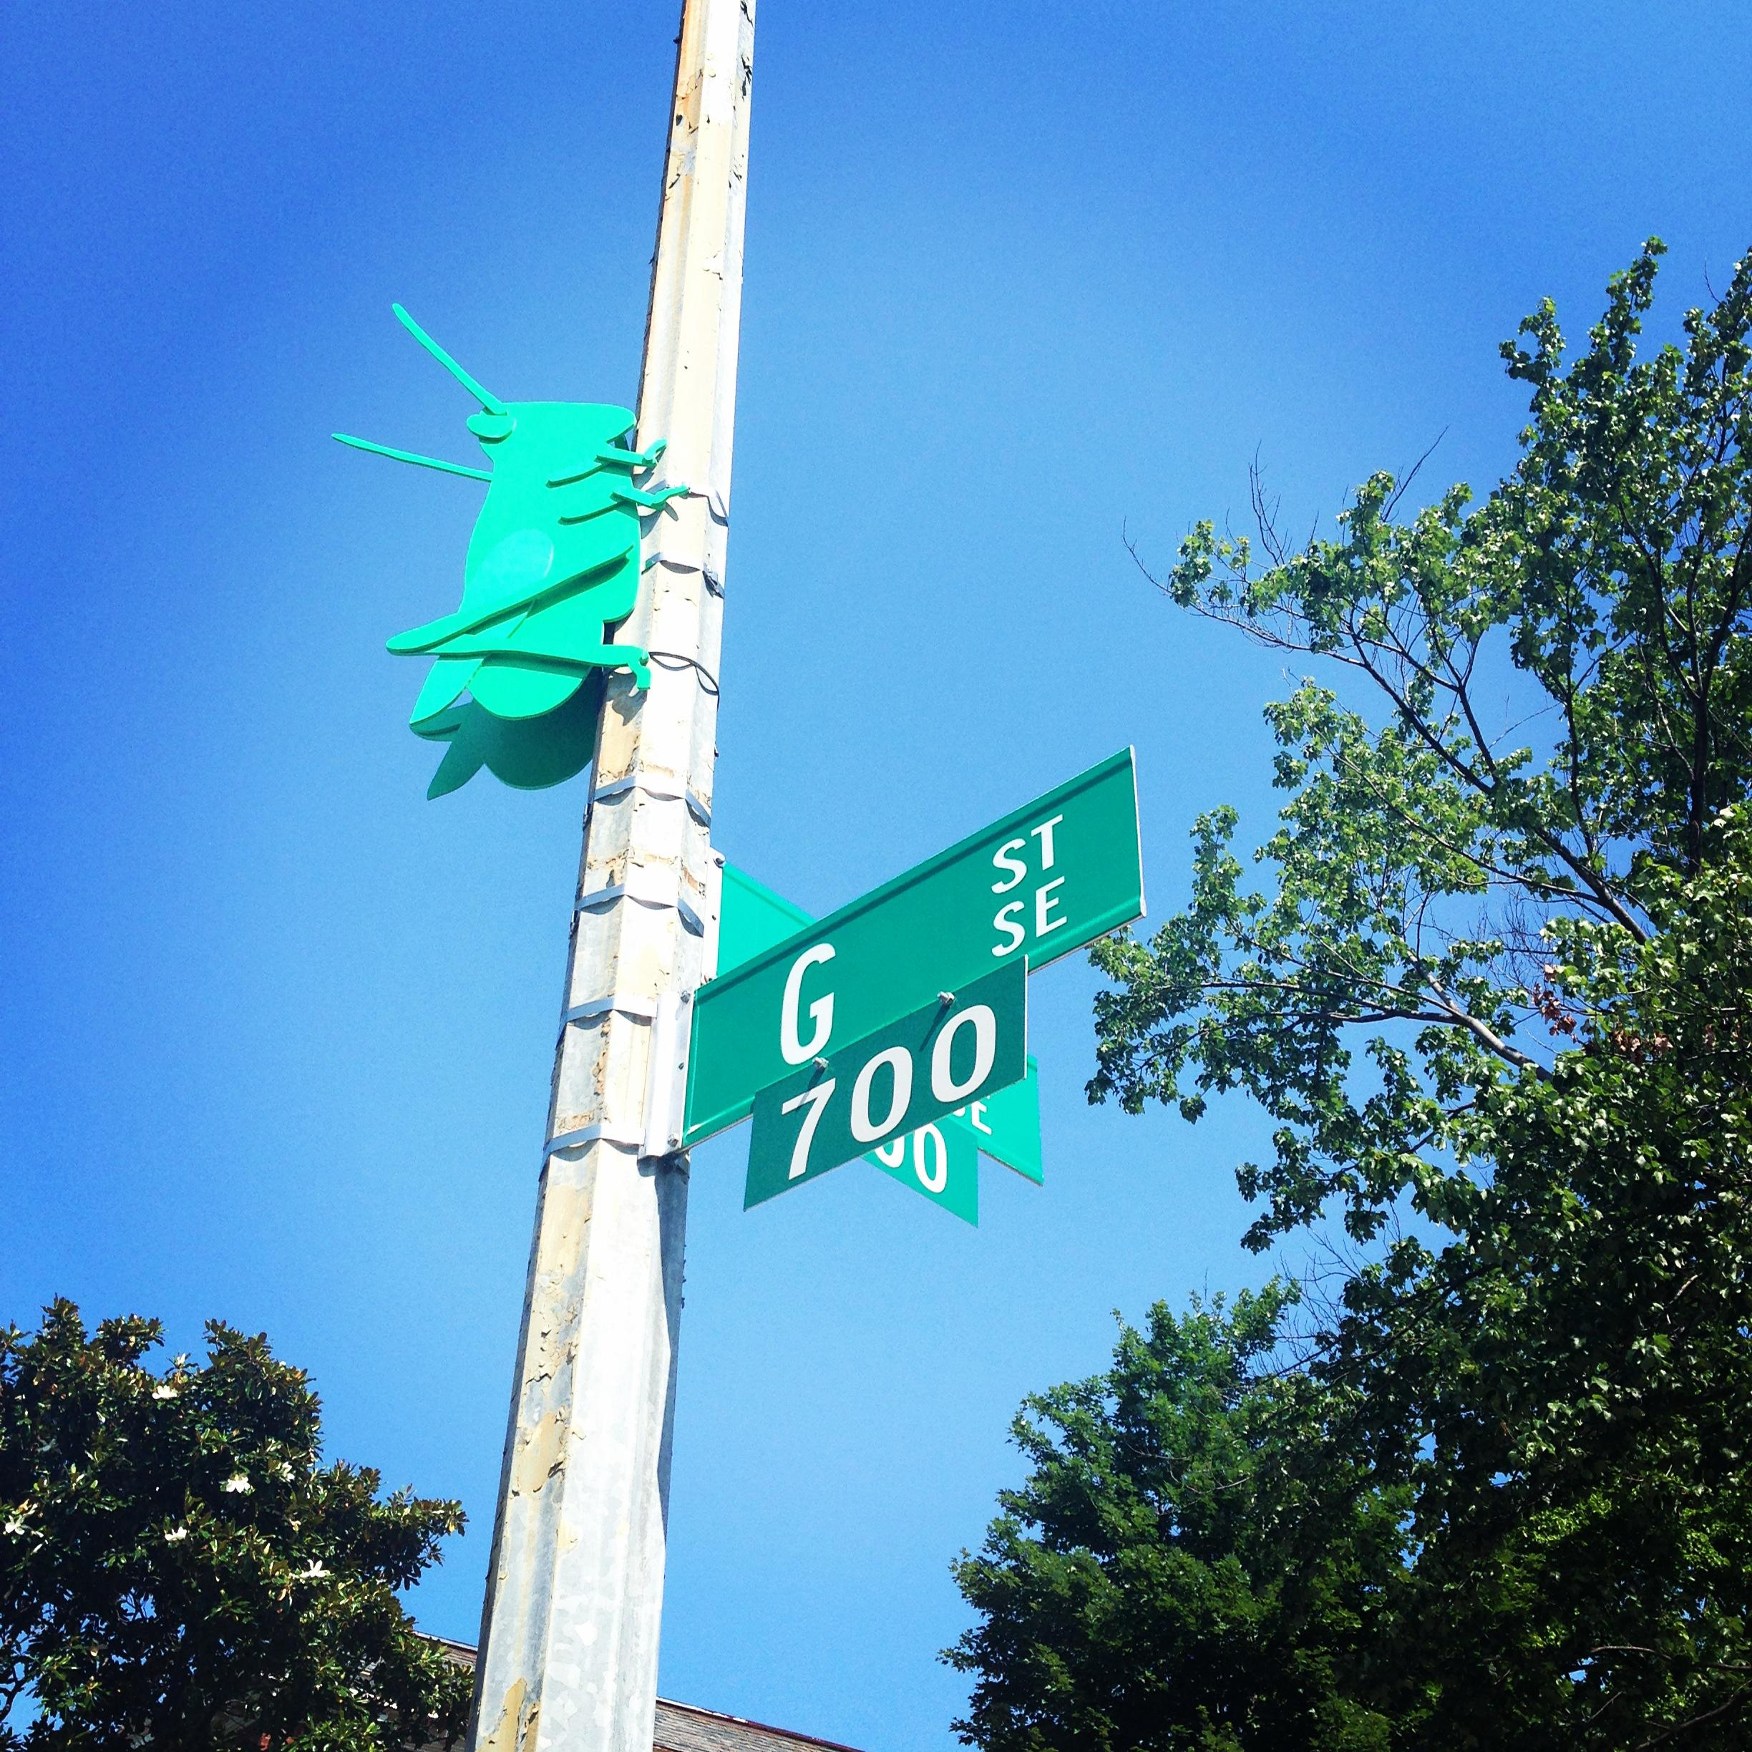
Notes:
The Capitol Hill Alphabet Animal Art Project (CHAAAP) was originally conceived nearly a decade ago by a father walking with his two children in Capitol Hill. As he walked past lettered street names, he pointed out, “K Street—K is for Kangaroo.” He brought the idea to CHAW, and so the Alphabet Animals were born. The original ten sculptures were created with the spirit of linking our neighborhood by leading with great art, and promoting walkability, livability, and a whole lot of character!

Slide 5
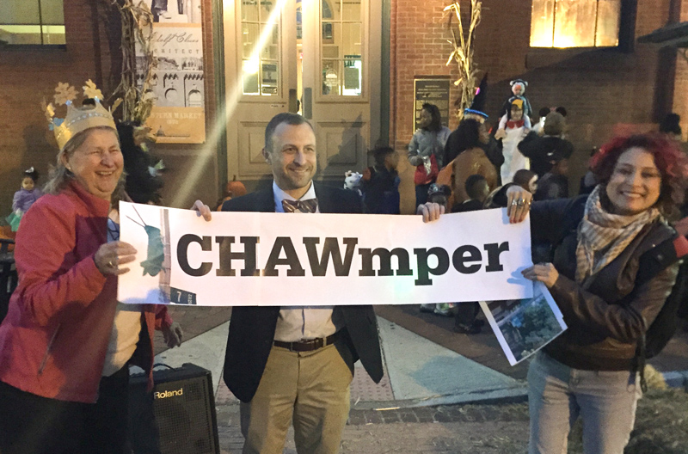
Community

Slide 6
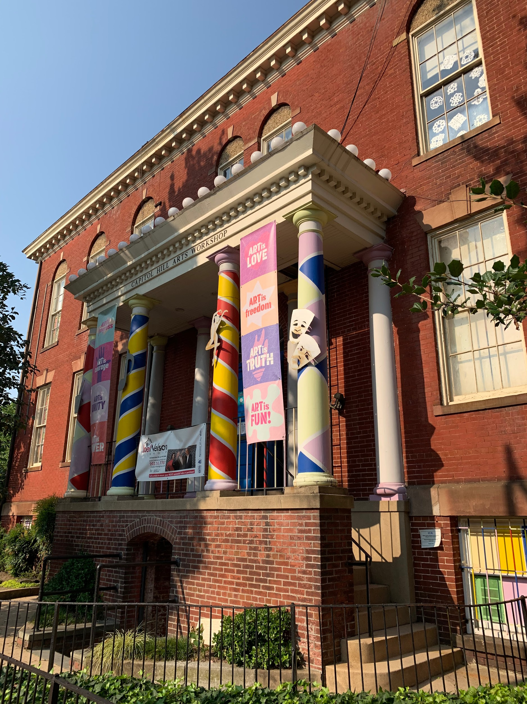
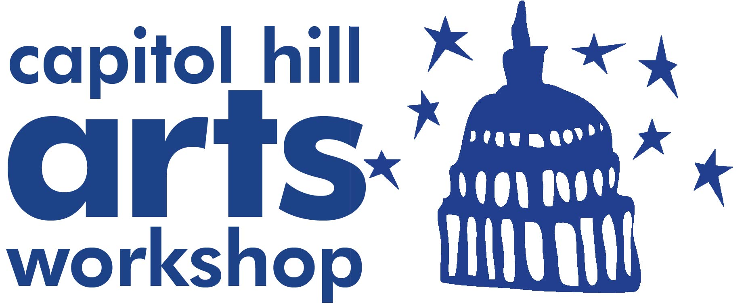
With support from
& the Capitol Hill Community Foundation
Notes:
If we were in person, we’d be starting right here, outside the Capitol Hill Arts Workshop. In the chat box, let us know if you’ve been to CHAW before--on the corner of 7th & G St. SE. First, I want to give you a little bit of background on why we started this project, and why CHAW.
For nearly 50 years, CHAW has been a hub for the meaningful exchange of ideas through art-making in community both inside and outside of its walls. This expansion of the Alphabet Animals project speaks directly to CHAW’s focus on both creative expression and the power of partnerships to uplift the arts; connecting diverse groups of people, supporting local artists, facilitating arts-driven community networks with businesses, schools, social services and other arts organizations, and encouraging civil discourse through creativity. Our mission is rooted in the idea that art and community building are synergistic. This project provides an important entry point for a variety of stakeholders to take ownership in the creative potential of their neighborhood and directly experience the connective power of the arts.

Slide 7
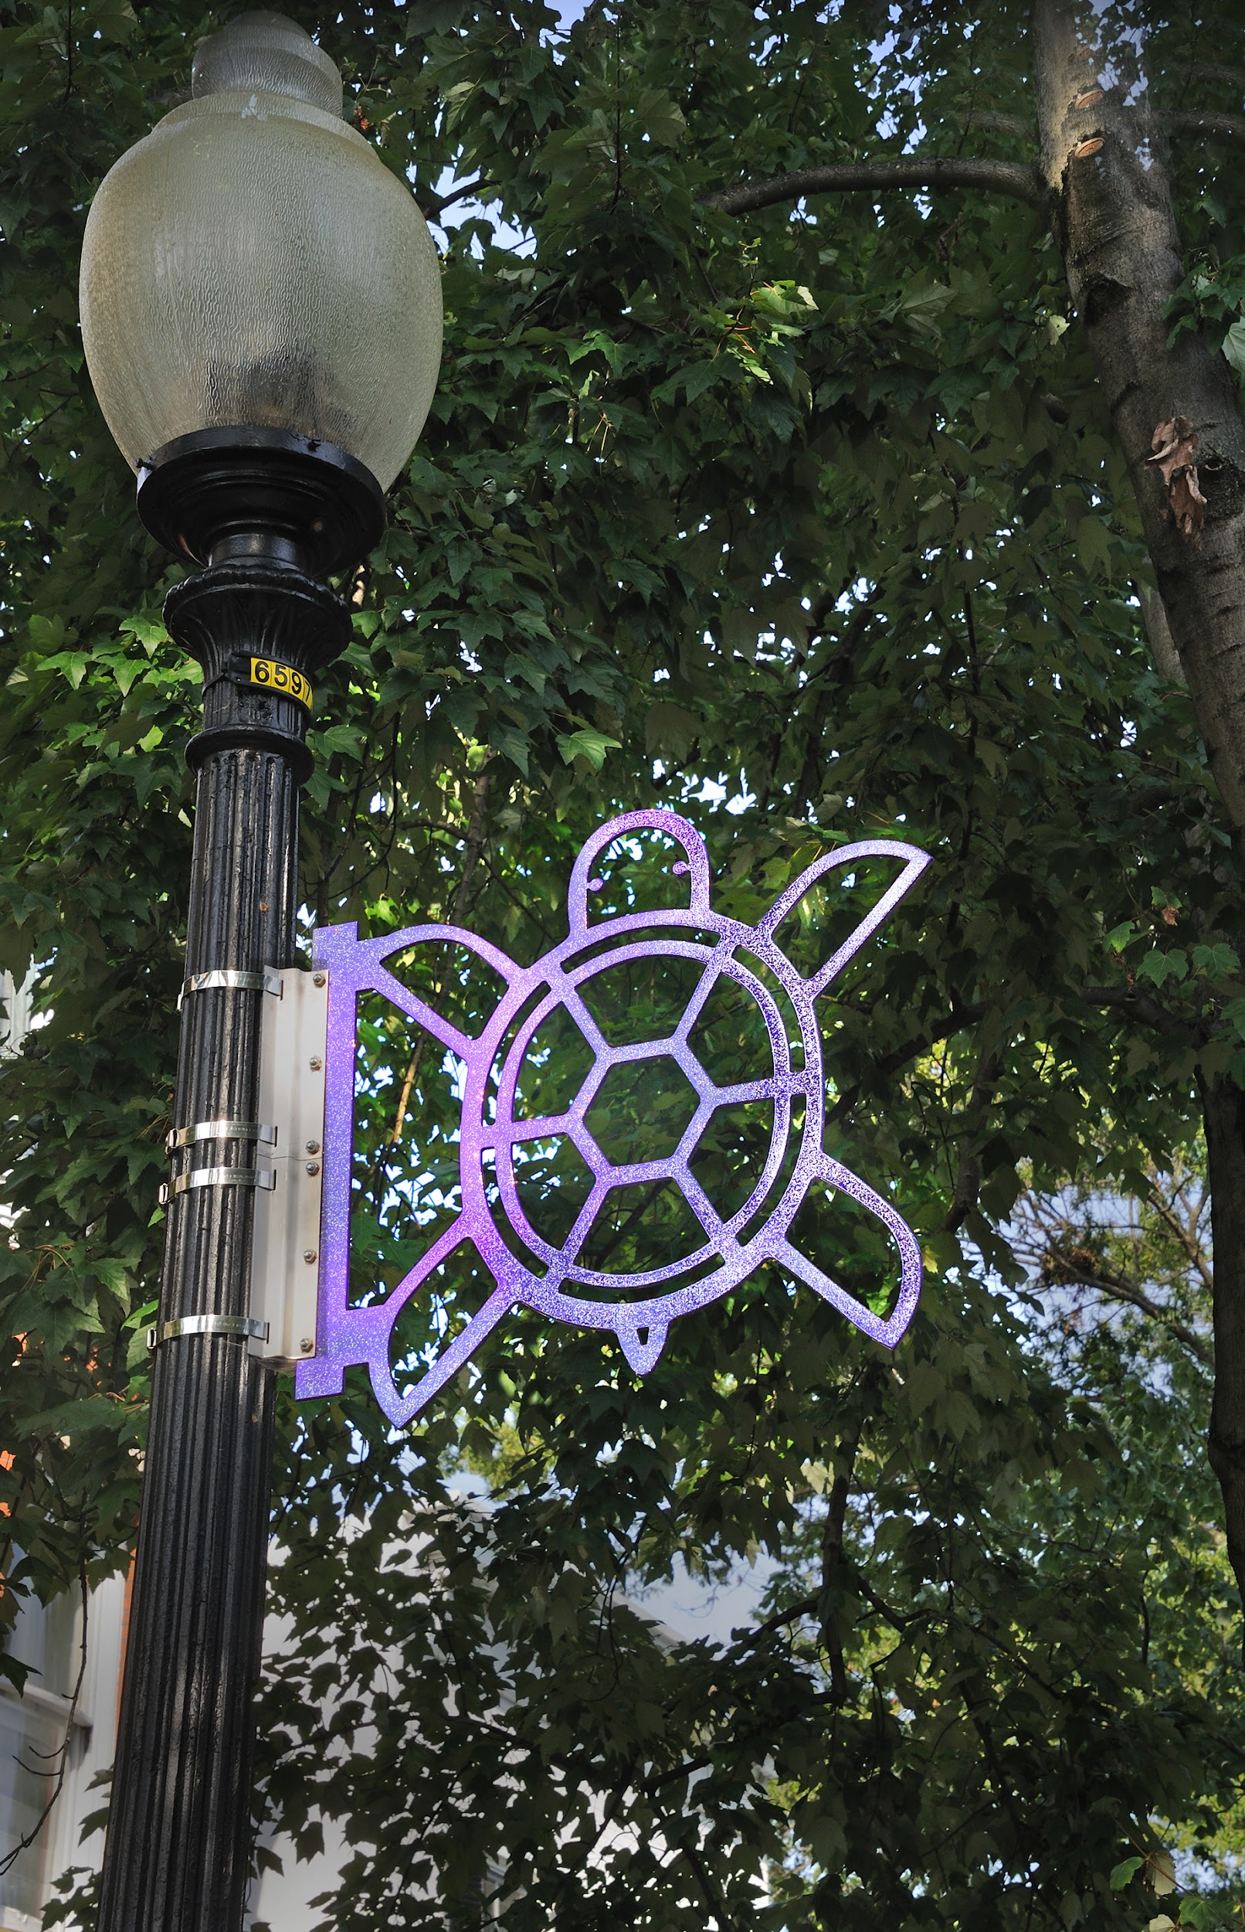
TURTLE
By the artist team of Breon Gilleran & Mimi Frank
F St. Terrace SE (Powder coated aluminum)
Photo Credit: Greg Staley
Notes:
-pass to Breon

Slide 8
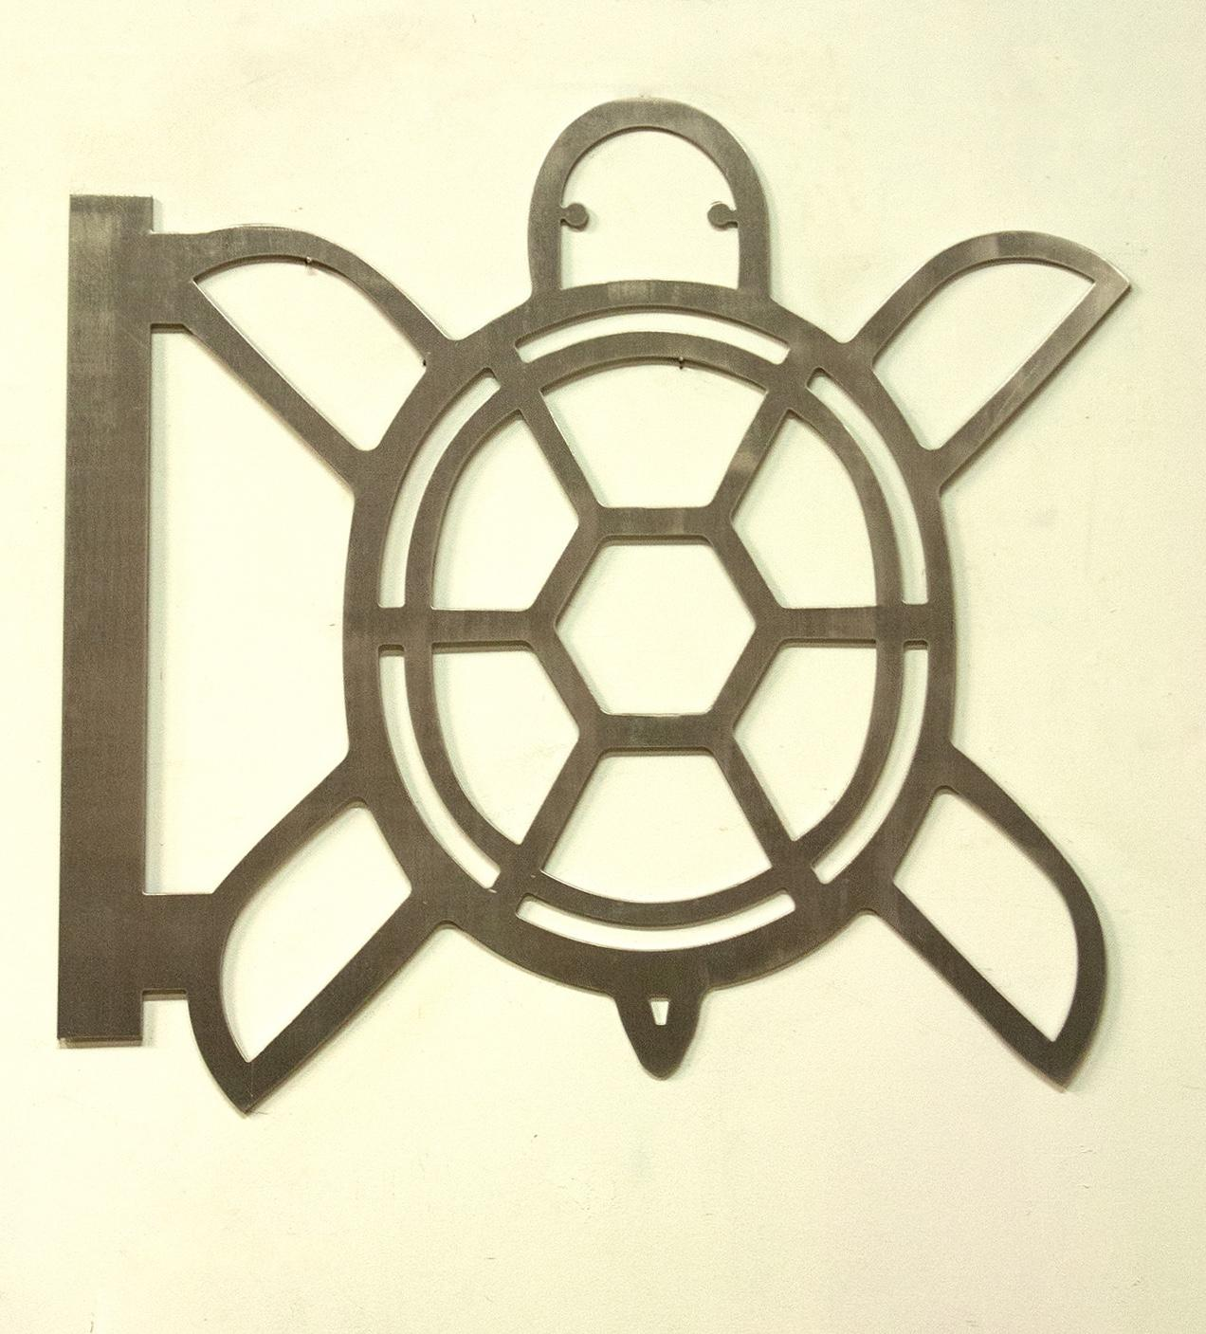
Turtle in process: Breon Gilleran & Mimi Frank

Slide 9
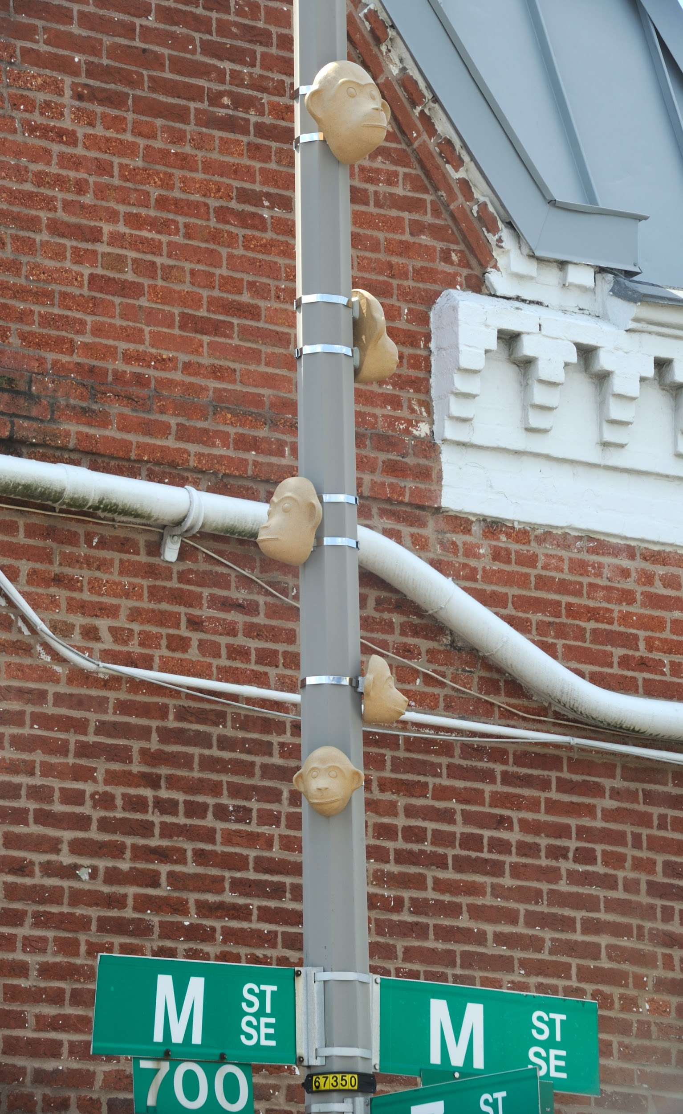
MONKEYS
By Undine Brod
7th & M St. SE (Clay)
Photo Credit: Greg Staley
Notes:
-out of the gallery, into the community
-joy in someone’s commute - large, main street

Slide 10
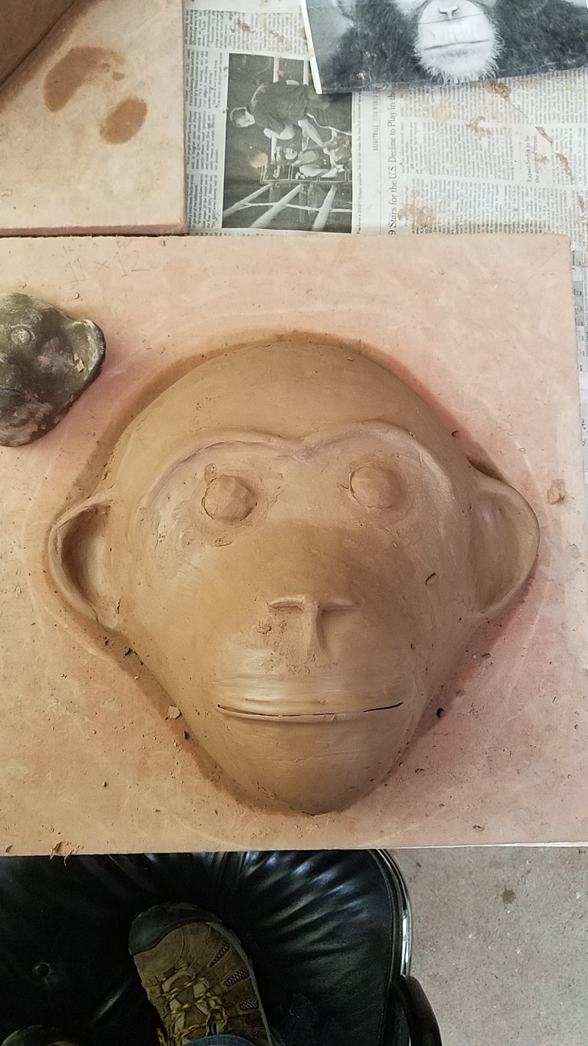
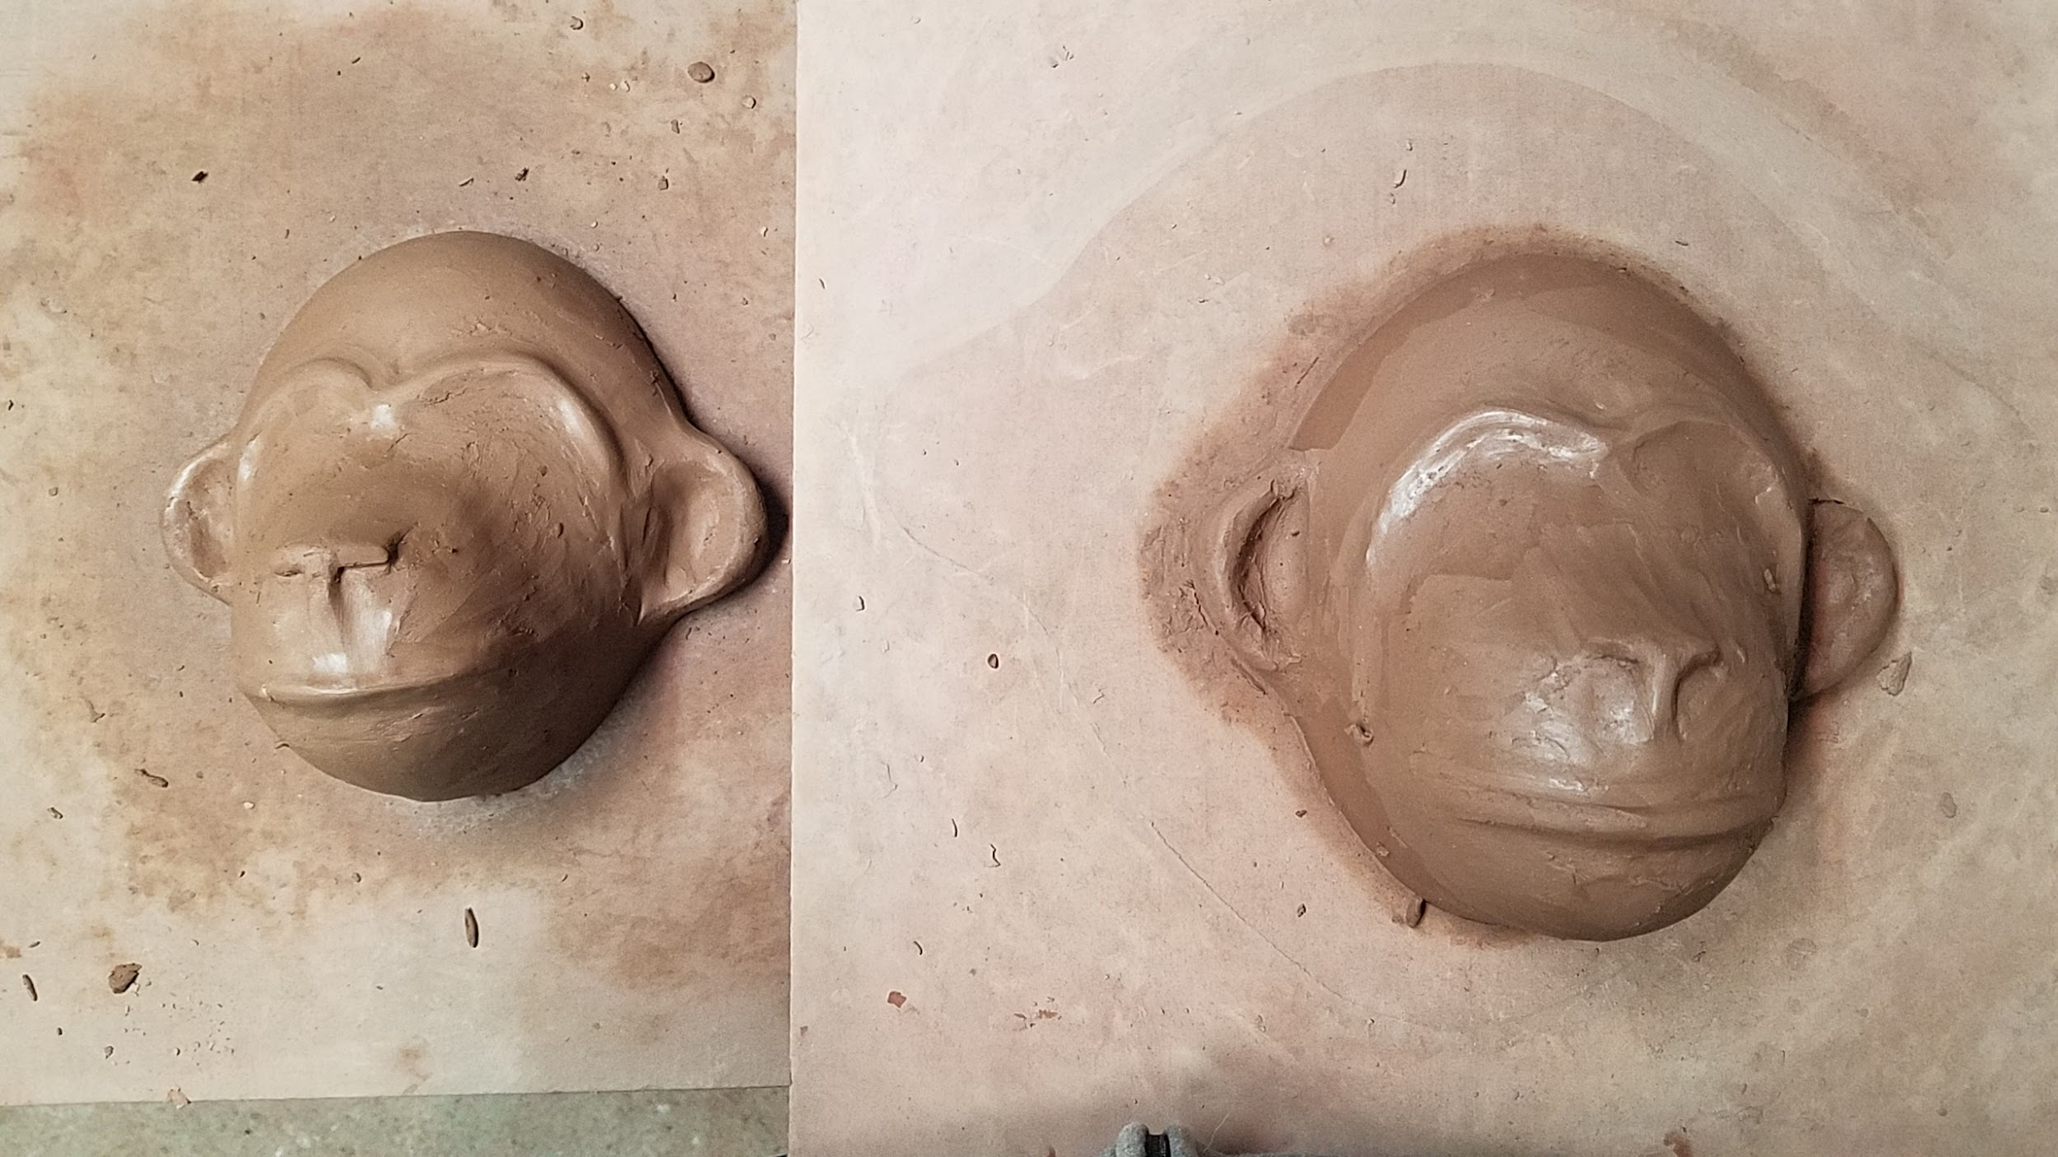
Monkeys in process: Undine Brod
Notes:
A challenge for me with this project is that I don’t generally work creating representational animals. Up until now the animals in my sculptures have been unidentifiable, ambiguous, hybrids. I needed to use reference photos to sculpt the recognizable and identifiable animals.

Slide 11
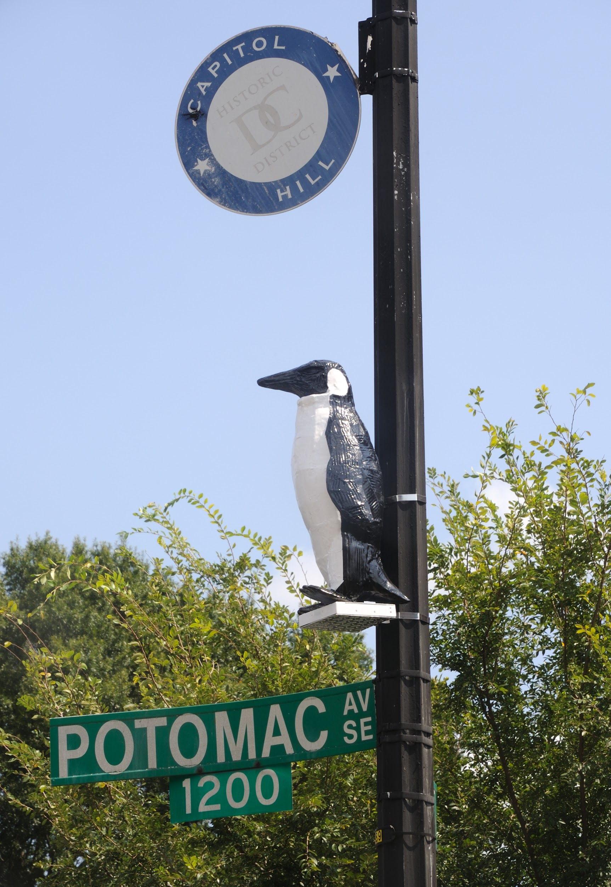
PENGUIN
By Evan Reed
Potomac & K St. SE (Cardboard, epoxy resin, paint and aluminum)
Photo Credit: Greg Staley
Notes:
I want to pause here to talk a little bit about the relationship of these pieces. It is of particular importance to the success of the Alphabet Animals that they be accessible and available to anyone out on the street in their neighborhood. That’s part of what makes public art so special and so interesting in how we can think about the work. For example, all sculptures have to be high enough to be visible, and also away from other signs (this is why we work with DDOT!). The animals have to weigh less than 7 lbs, and have enough holes or be small enough so that wind doesn’t catch them and treat them like a “sail.” The ubiquitousness of light poles allows for an even field--the sculptures will all be displayed in the same way across neighborhoods, providing consistency and recognizability for all populations.

Slide 12
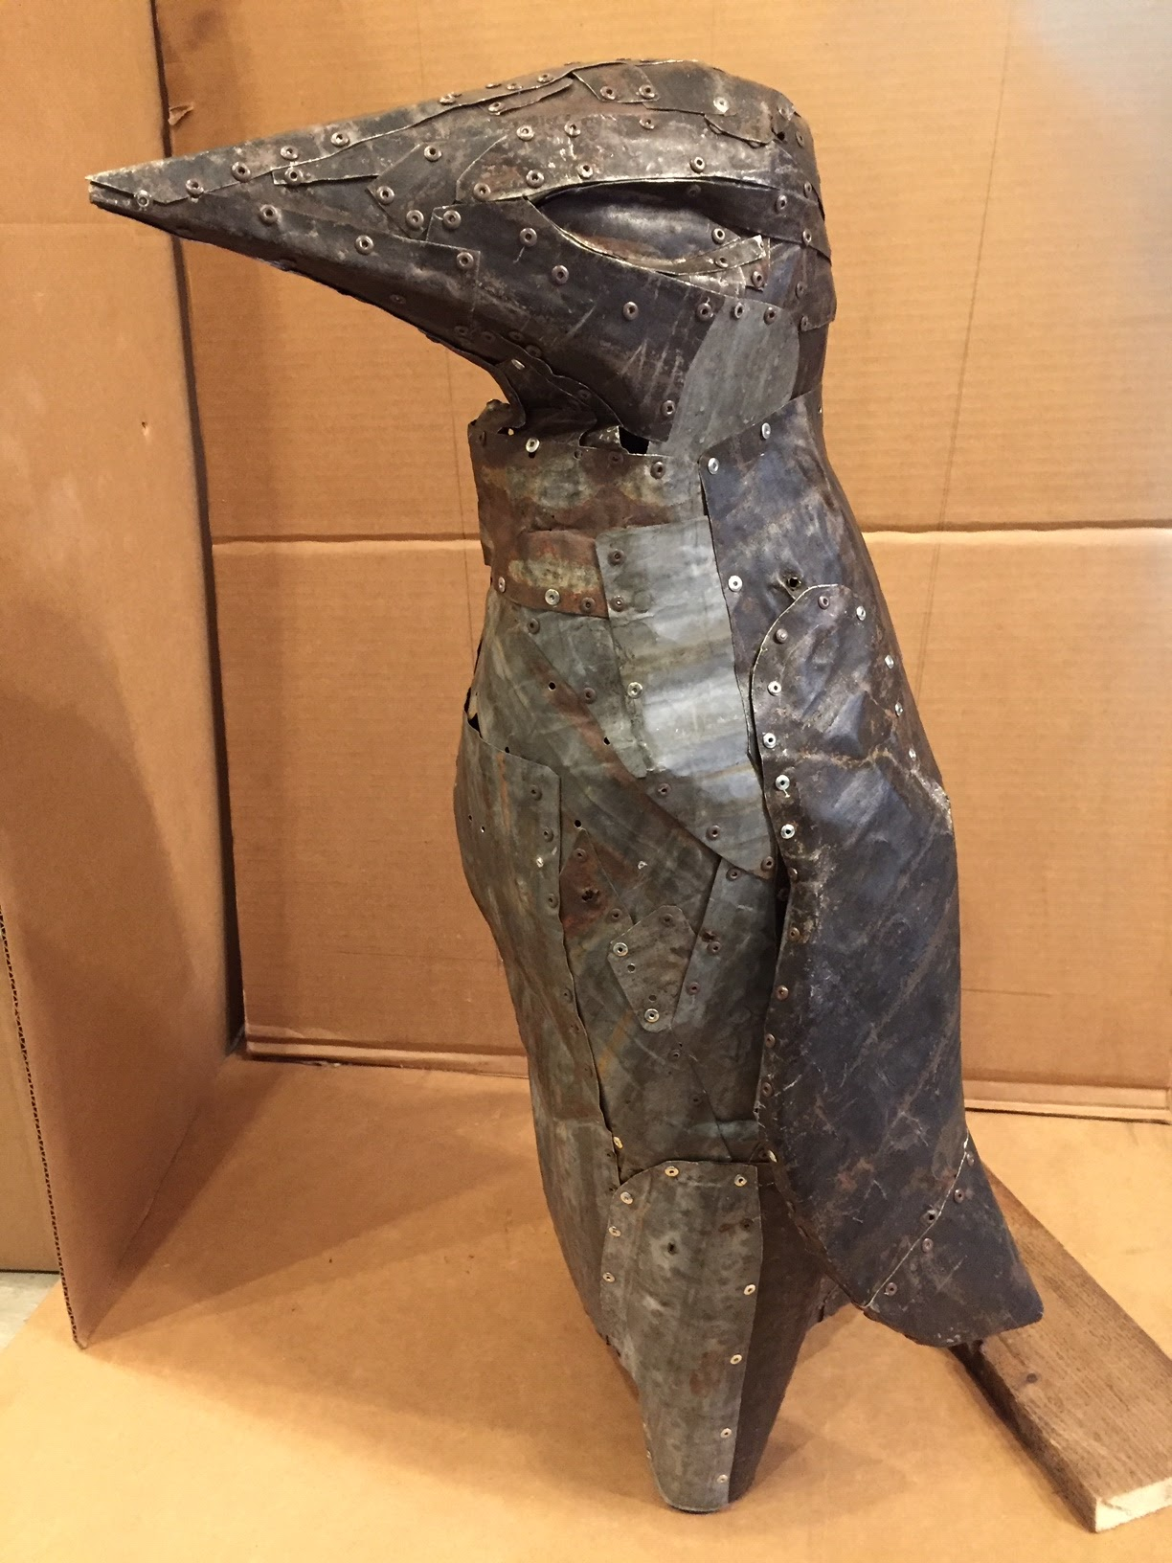
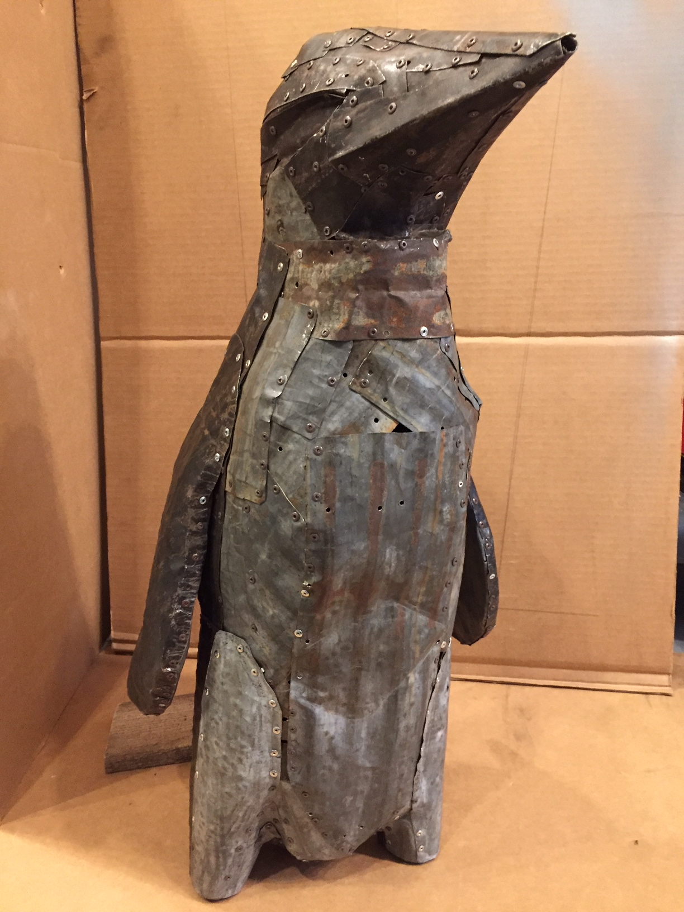
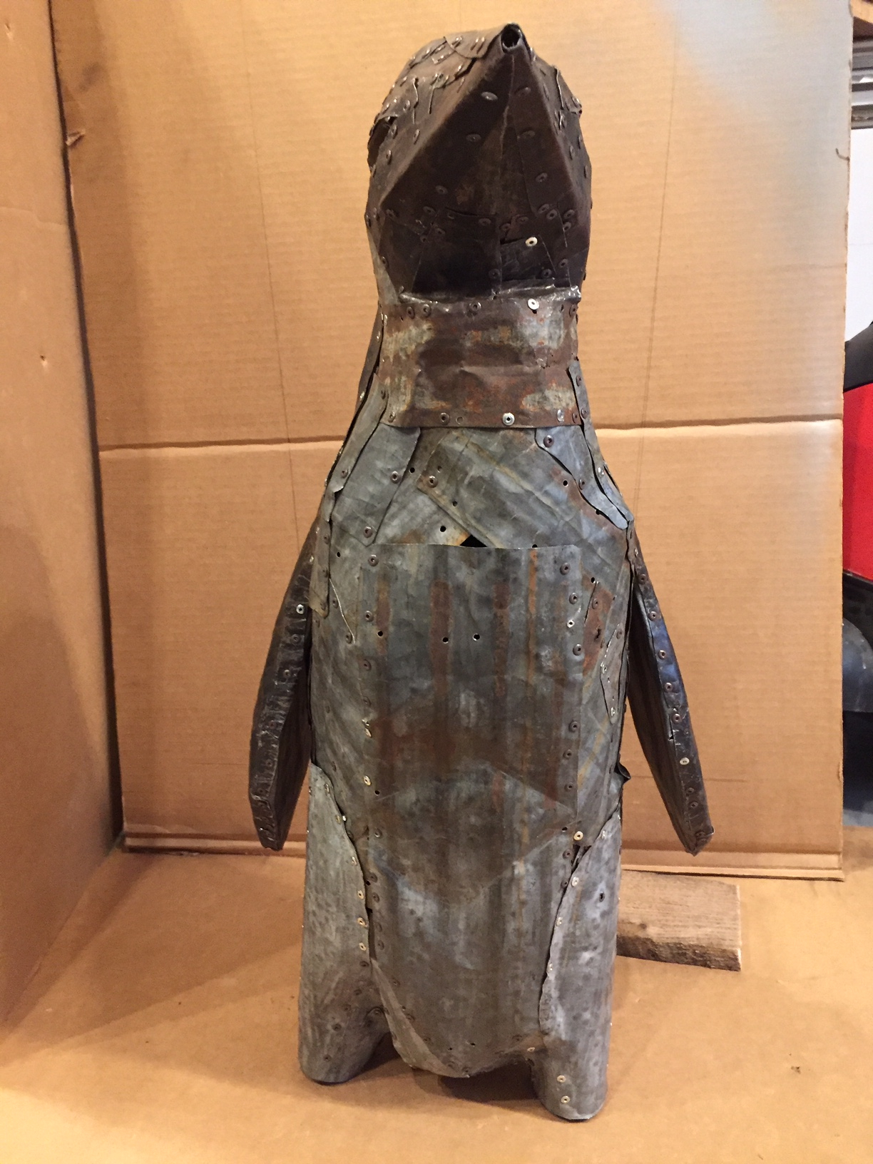
Penguin in Process: Evan Reed
Notes:
In my view penguins are complex creatures, comical and mysterious. They amusingly waddle around and instead of flying they swim. On land their actions and anthropomorphic qualities make them relatable to me. Overall they seemed to be a good candidate for a public sculpture and the right fit for a neighborhood intersection with pedestrian traffic.

Slide 13
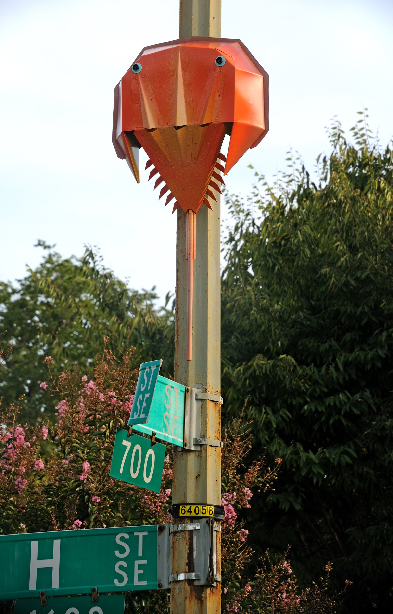
HORSE SHOE CRAB
By Susan Champeny
H & 16th St. SE (Bent aluminum, rivets, bolts, spray paint)
Photo Credit: Greg Staley
Notes:
-pass to Sue

Slide 14
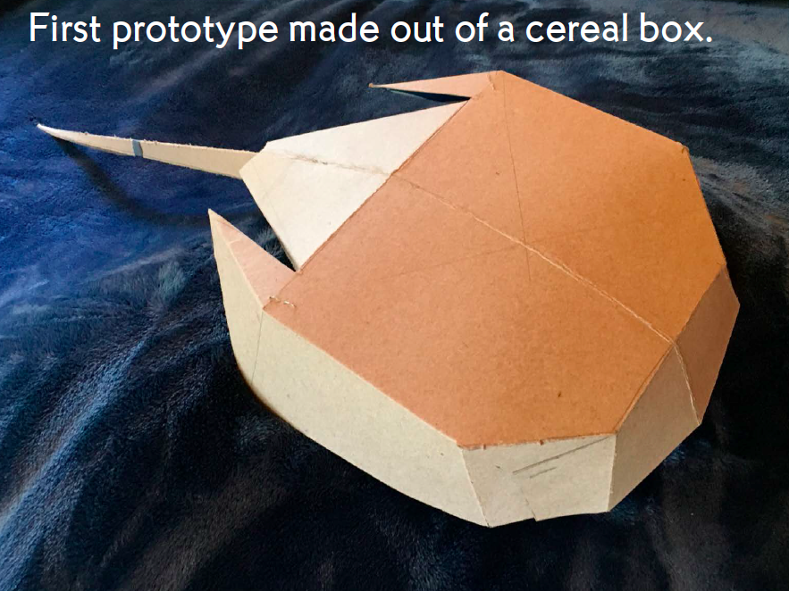
Horse Shoe Crab in Process: Susan Champeny

Slide 15
Horse Shoe Crab in Process: Susan Champeny

Slide 16
Horse Shoe Crab in Process: Susan Champeny

Slide 17
Horse Shoe Crab in Process: Susan Champeny

Slide 18
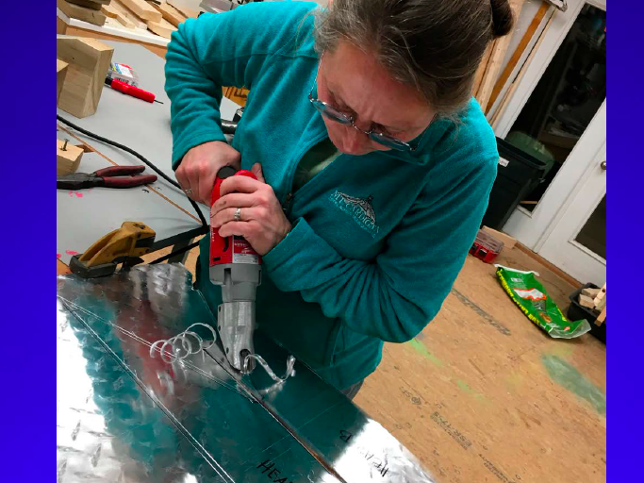
Horse Shoe Crab in Process: Susan Champeny

Slide 19
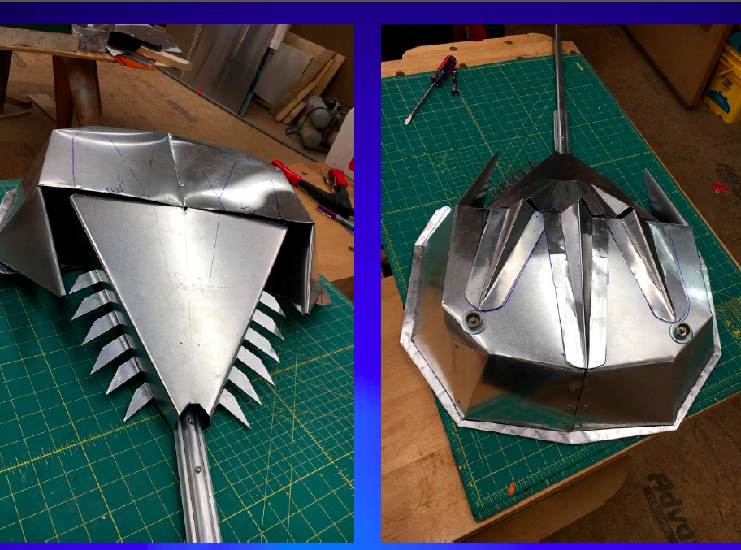
Horse Shoe Crab in Process: Susan Champeny

Slide 20
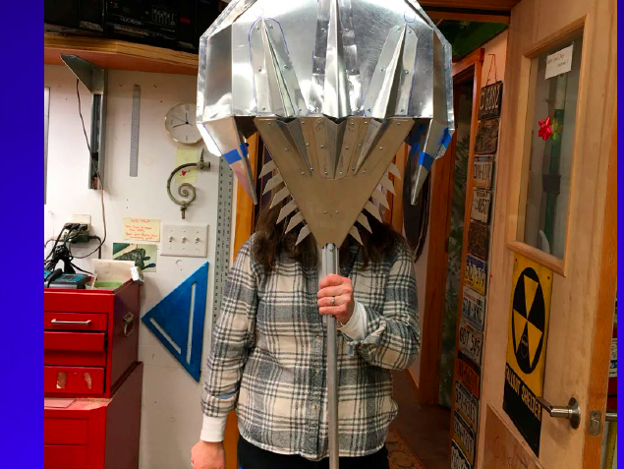
Horse Shoe Crab in Process: Susan Champeny

Slide 21
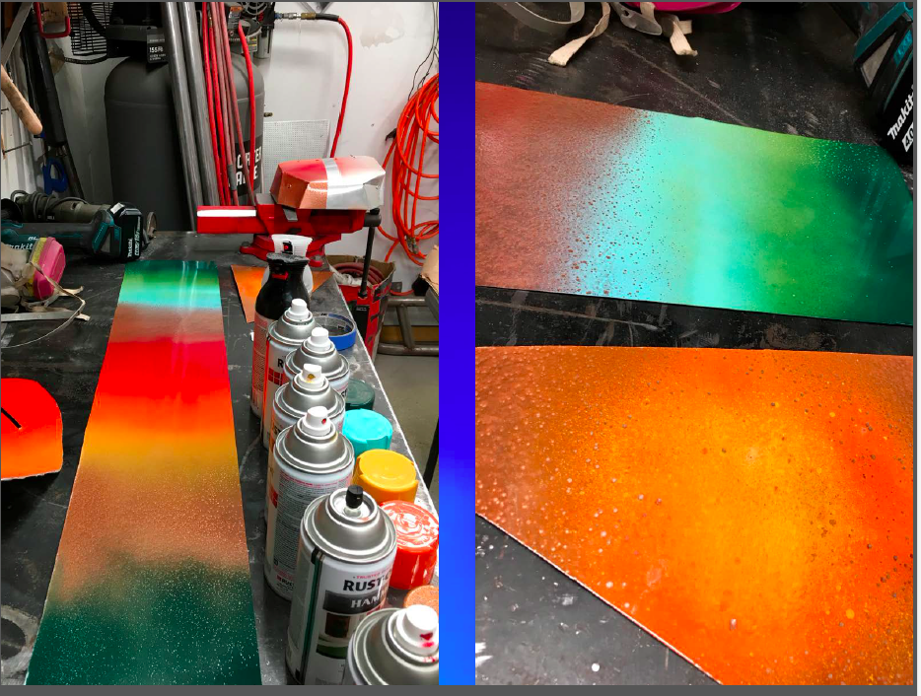
Horse Shoe Crab in Process: Susan Champeny

Slide 22
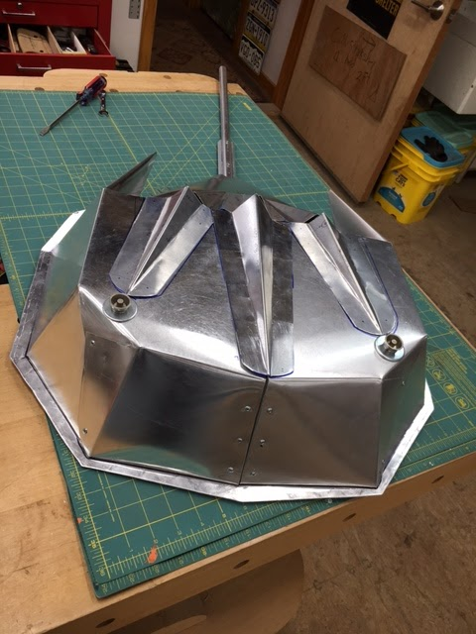
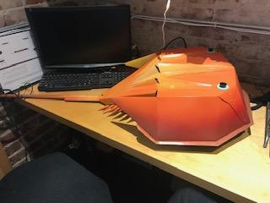
Horse Shoe Crab in Process: Susan Champeny

Slide 23
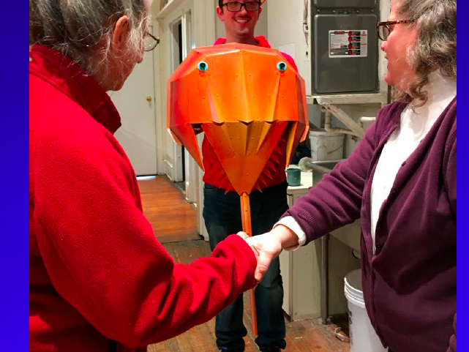
Horse Shoe Crab in Process: Susan Champeny

Slide 24
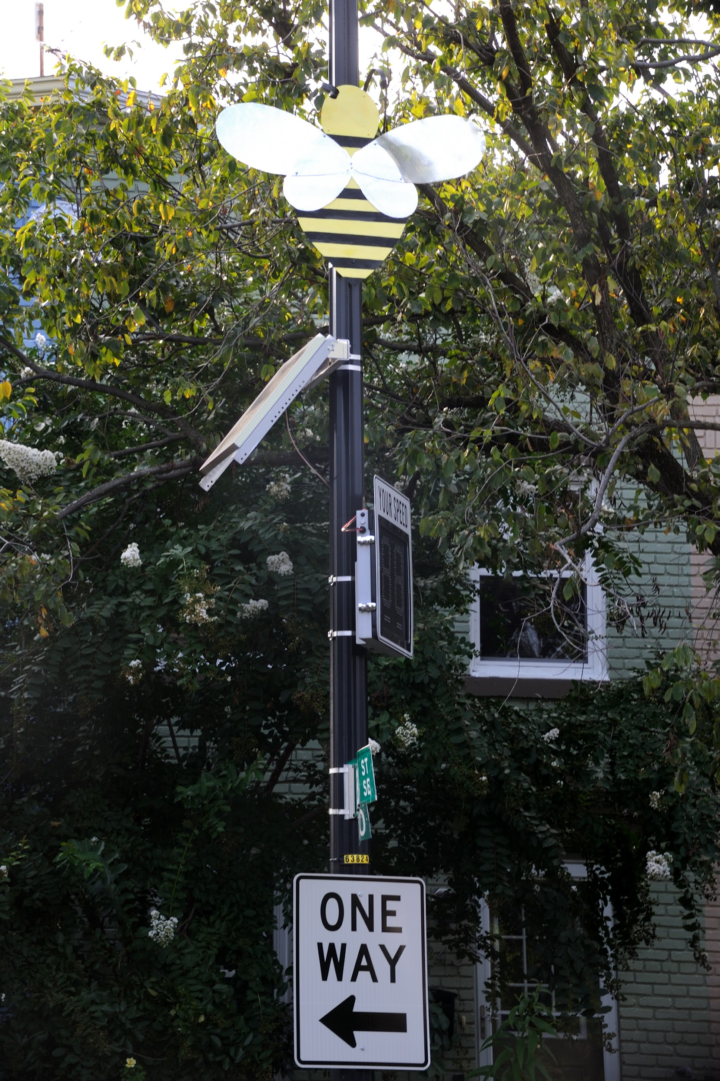
HONEYBEE
By Maureen Smith
Bay St. & 17th St. SE (Sheet Metal, Aluminum)
Photo Credit: Greg Staley
Notes:
I chose to create a honeybee for the piece -- I think bees are symbolic of community, vitality, and life. In various cultures and different time periods bees have been symbolic of many things -- good fortune, royalty, luck, and much more. With the present-day endangerment of bees due to climate change and environmental degradation, we’ve begun to realize that bees are essential to our existence (bees were recently declared by scientists to be the most important living beings on Earth!).
I think the intention behind most public art is to build some form of community, whether it’s to cultivate critical awareness of a social issue or simply to bring people together. At the beginning of this project creating something that evoked a sense of community felt important, but now given the pandemic it feels all the more essential. As we face unprecedented existential threats to our safety and ways of life, finding little ways to acknowledge our interconnectedness, build community, and feel a bit of joy seems more important than ever. So -- in short, I hope it makes folks feel some unexpected joy because we could all use more of that right now.

Slide 25
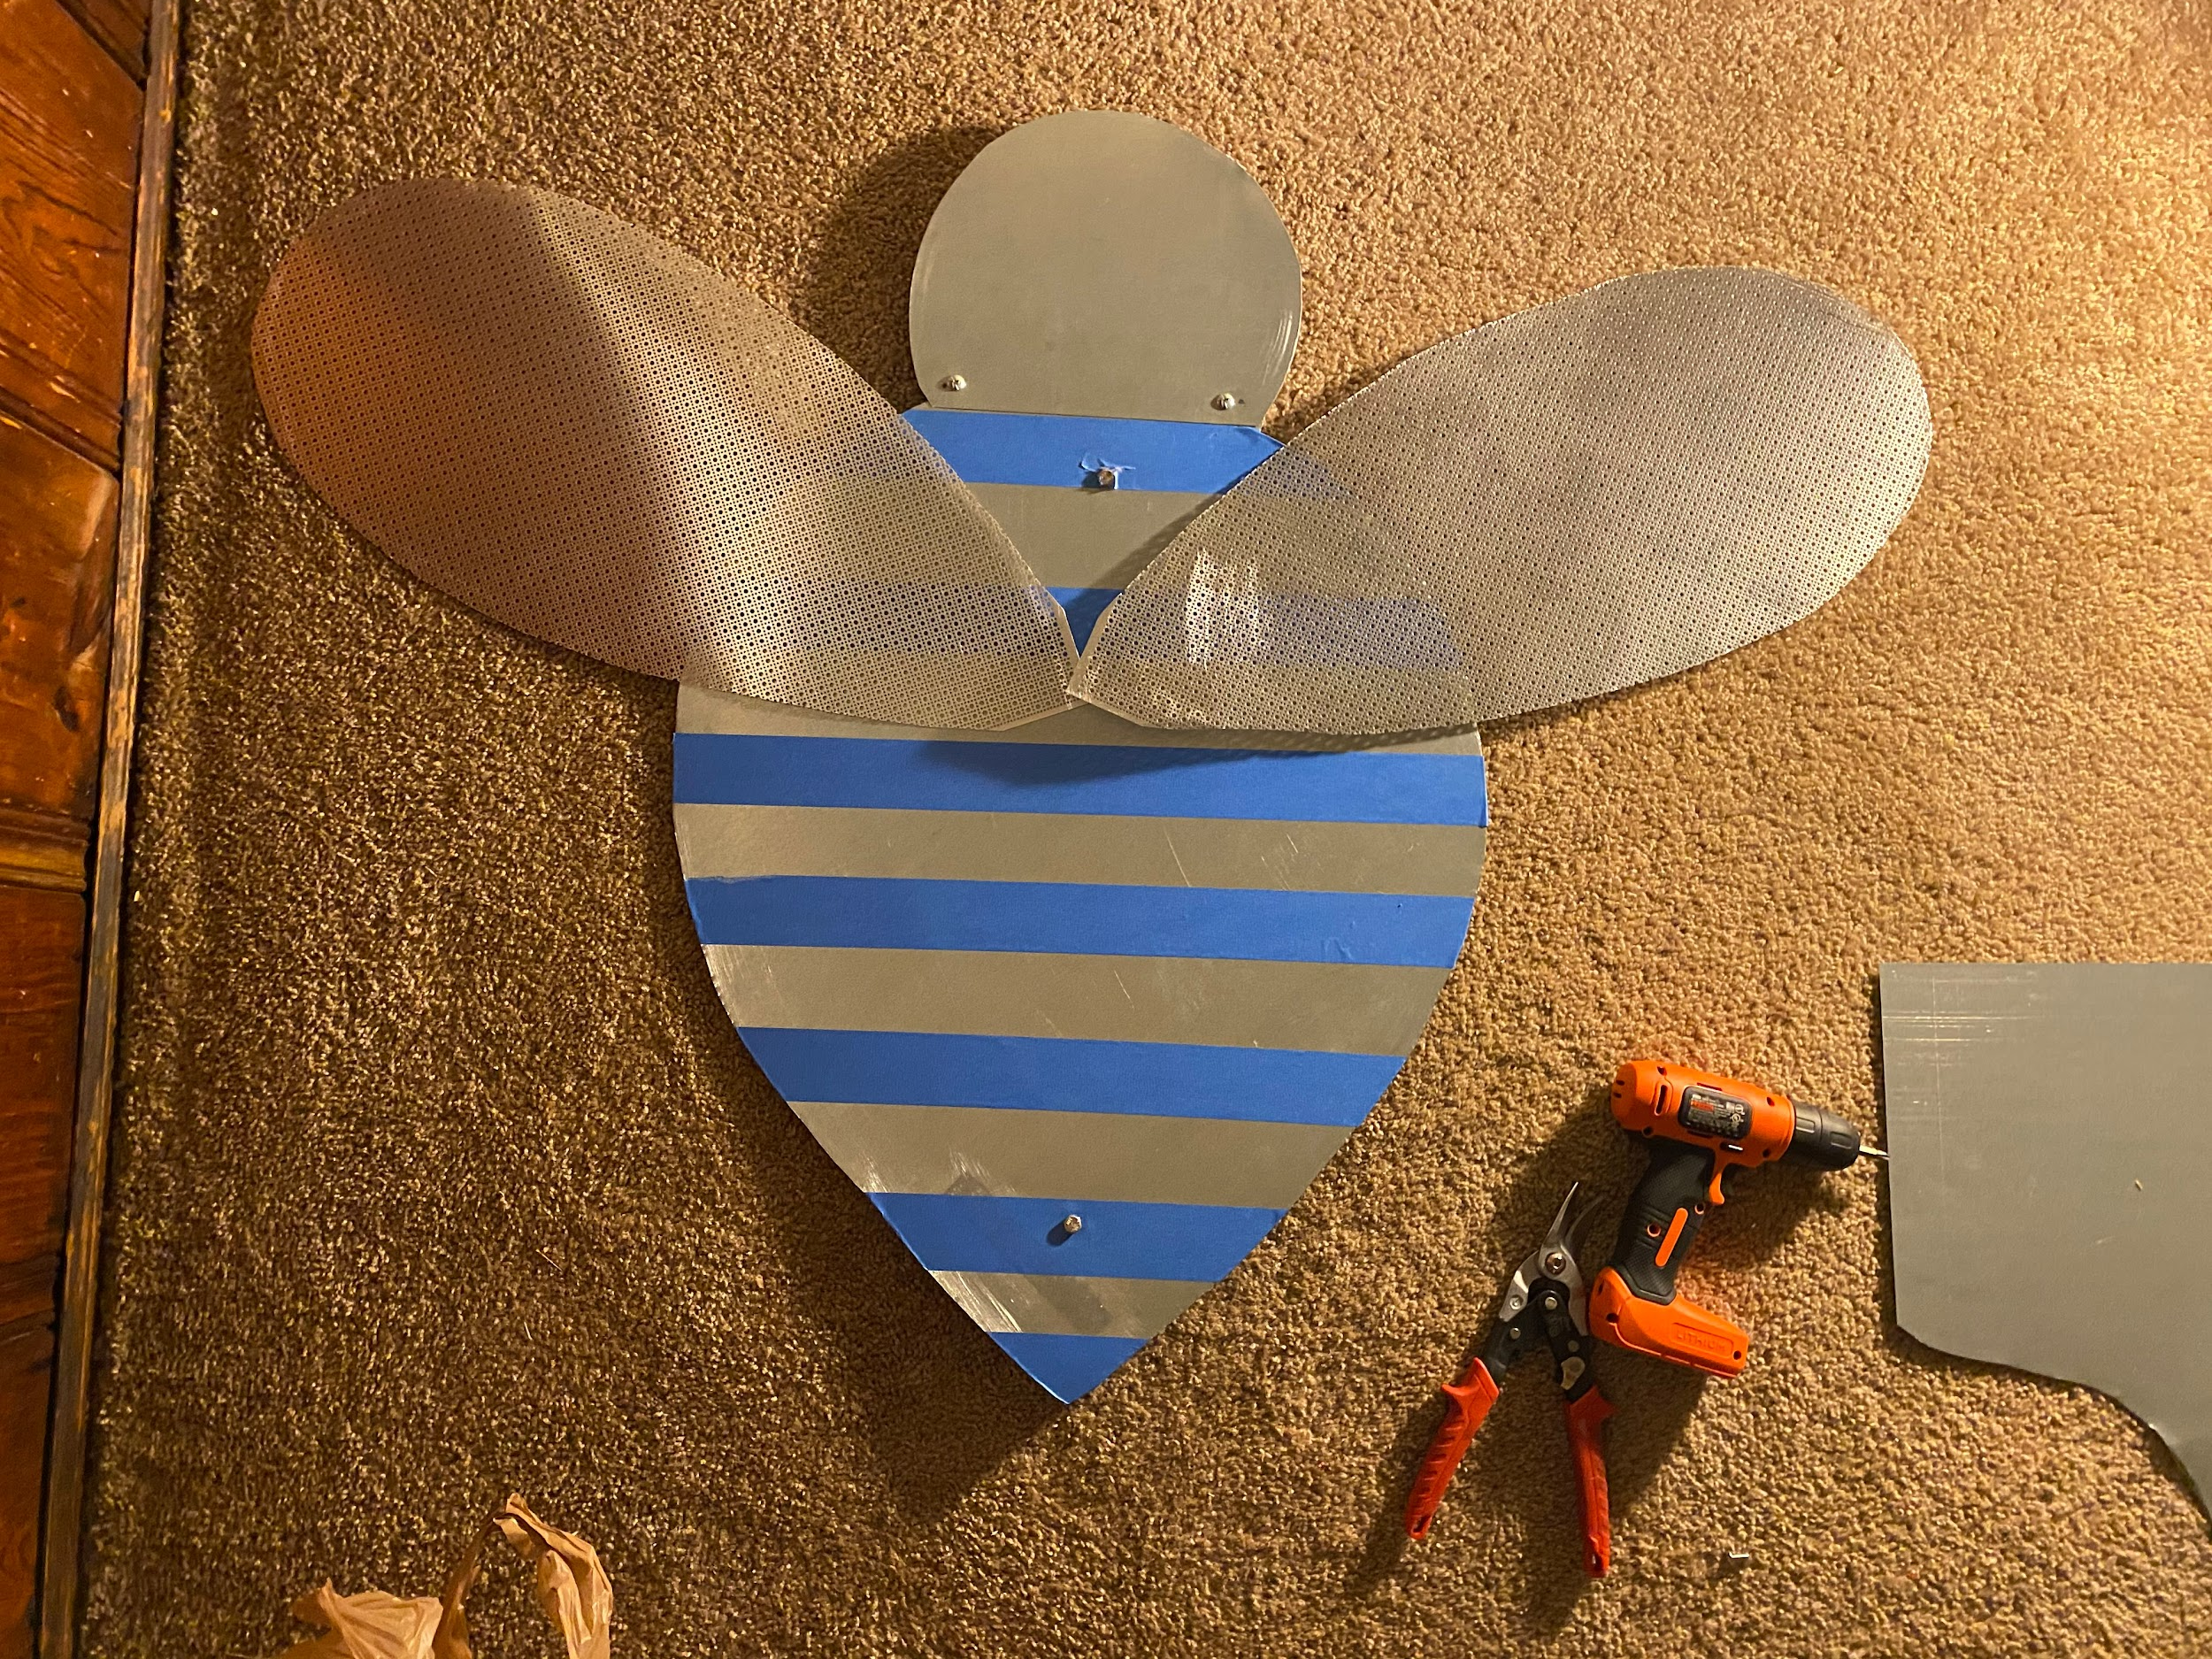
Honeybee in process: Maureen Smith
Notes:
I was drawn to participate in this year’s Alphabet Animals project for the opportunity to challenge myself and create beyond my traditional mediums of photography and painting. I was thrilled for the opportunity to dive into a new project -- especially a public art project, and to create something that would be enjoyed by the community. The process of creating the piece encouraged me to open myself up to experimenting with different techniques. It was my first time working three dimensionally in years -- and I loved the challenge of working with new materials and problem solving along the way.

Slide 26
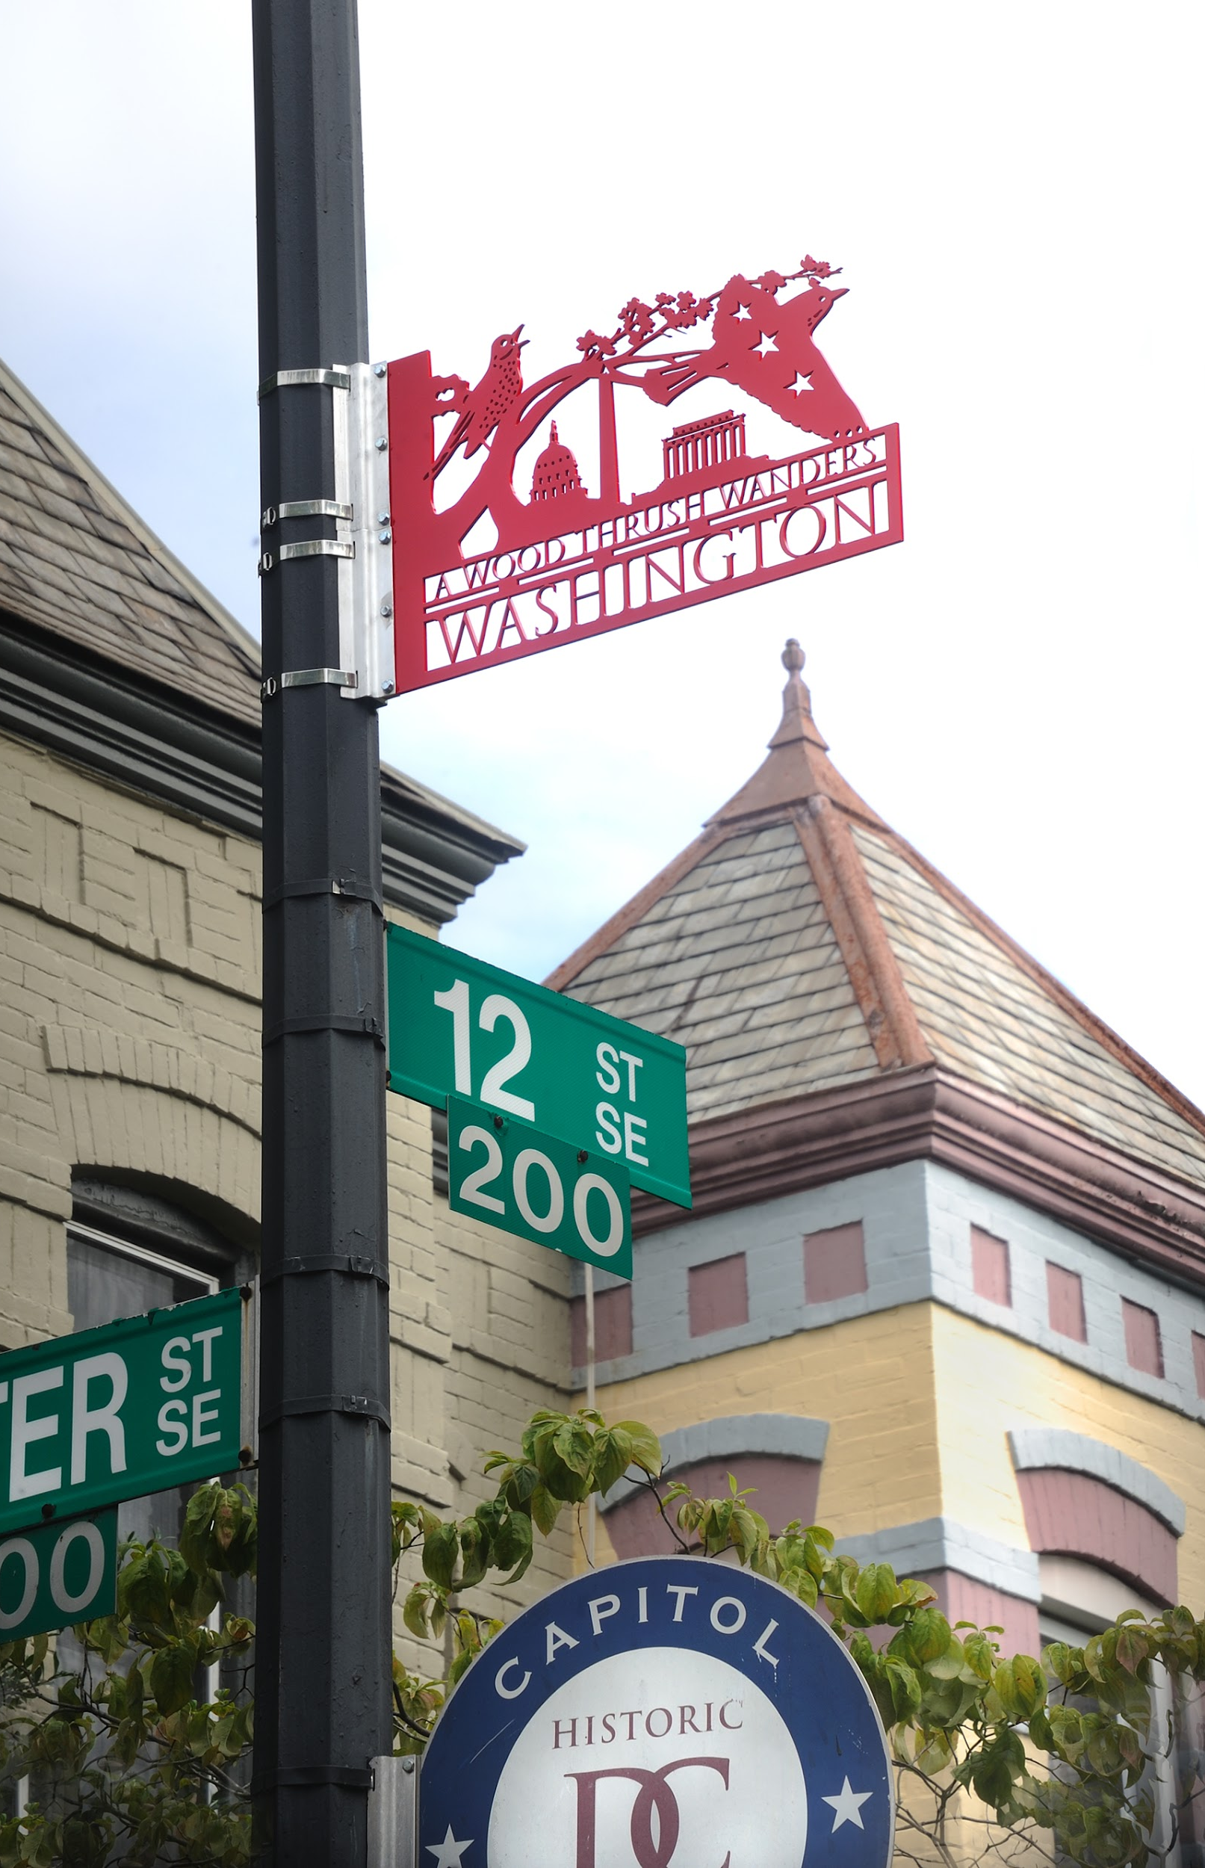
A WOODTHRUSH WANDERS WASHINGTON
By Charles Bergen
Walter St. & 12th St. SE (Waterjet cut structural aluminum with a powder coat finish)
Photo Credit: Greg Staley
Notes:
-artist, architect
-native Washingtonian
-simplified forms to engage with the viewer
-state bird, near endangered
-solitary, nests on the ground
-look for the bold, white eye ring!

Slide 27
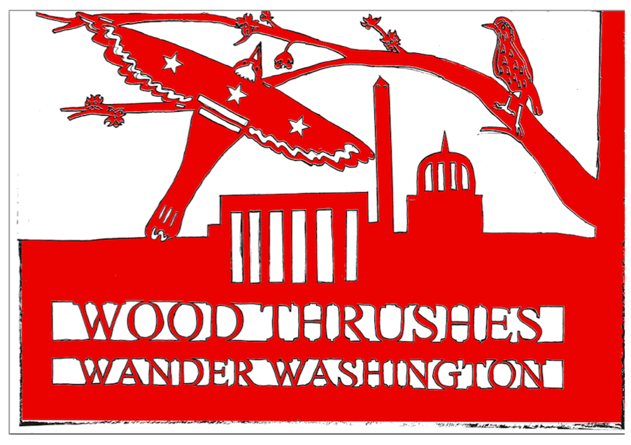
Woodthrush in process: Charles Bergen

Slide 28
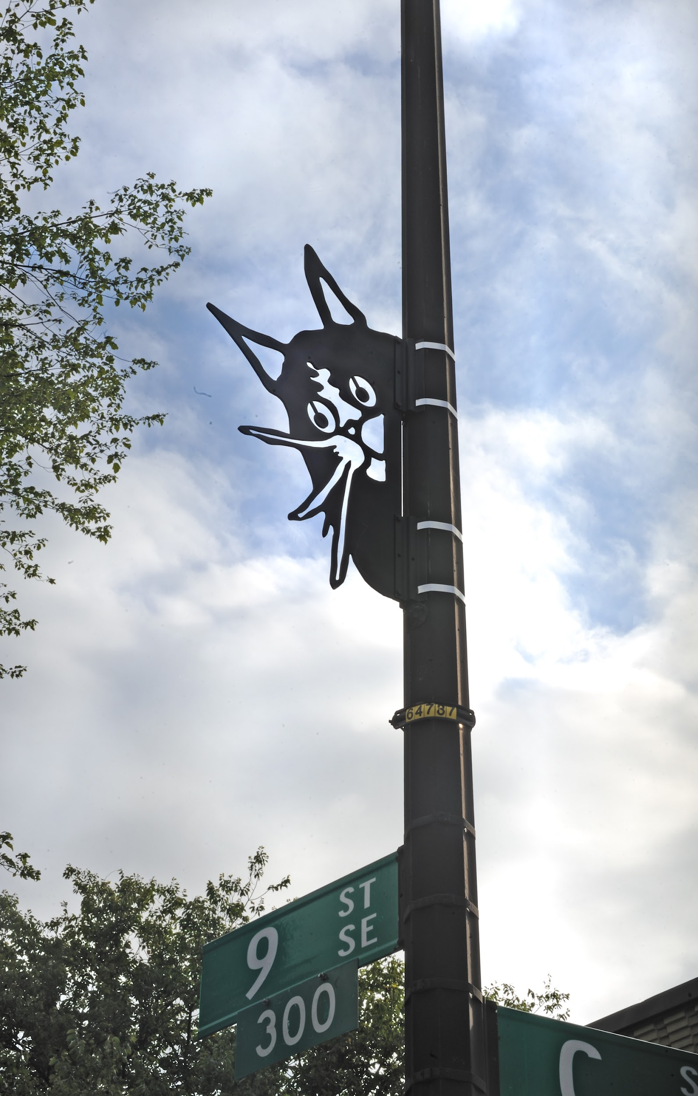
SNEAKY CAT
By Davide Prete
C & 9th St. SE (Painted aluminum)
Photo Credit: Greg Staley
Notes:
-Pass to Davide

Slide 29
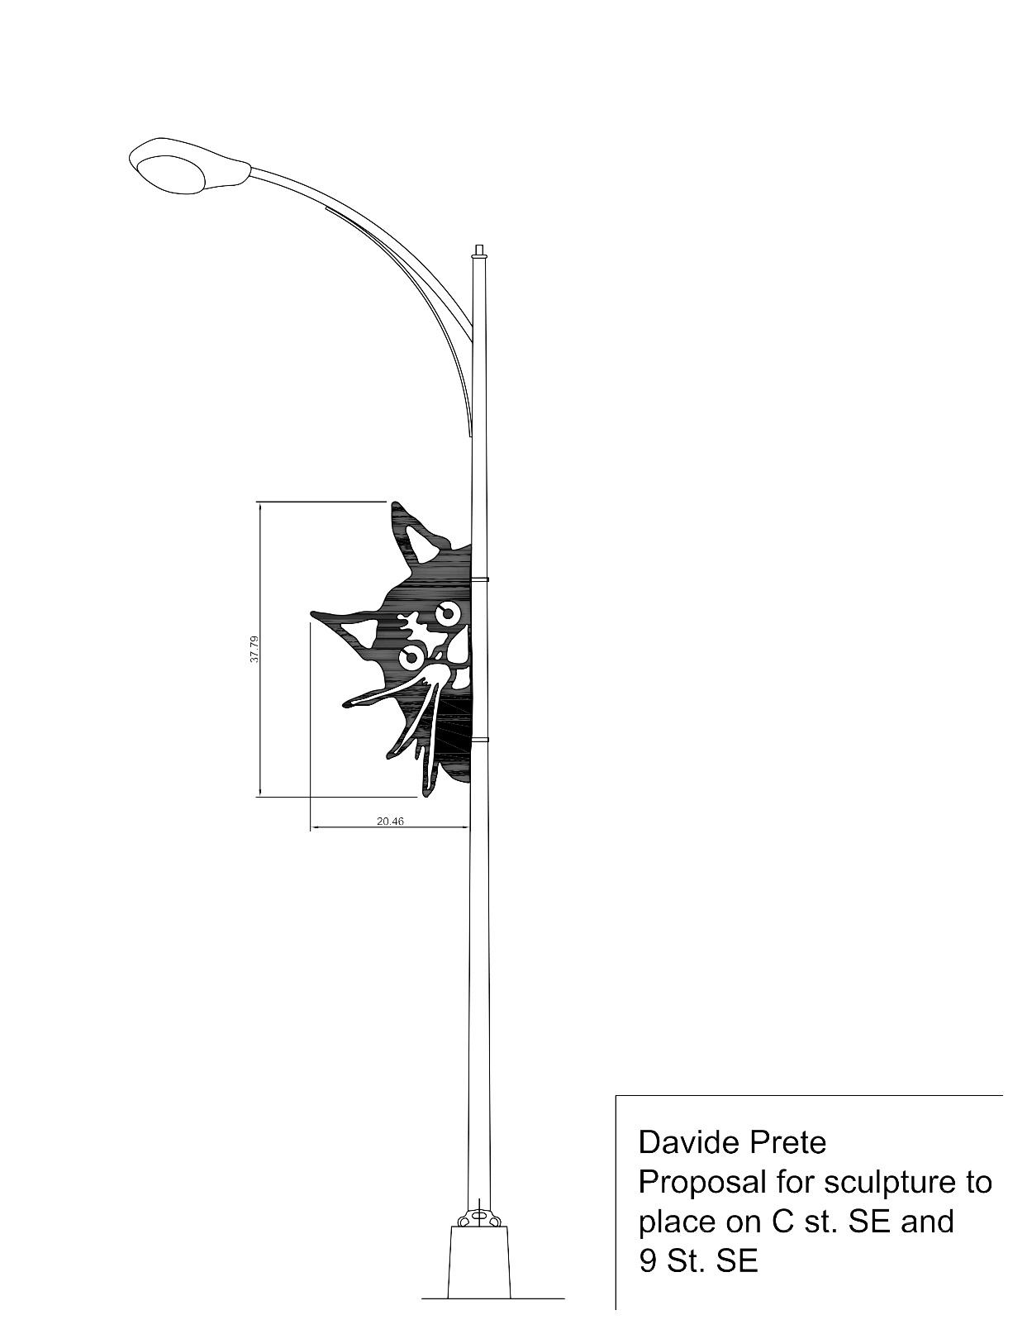
Sneaky Cat in process: Davide Prete

Slide 30
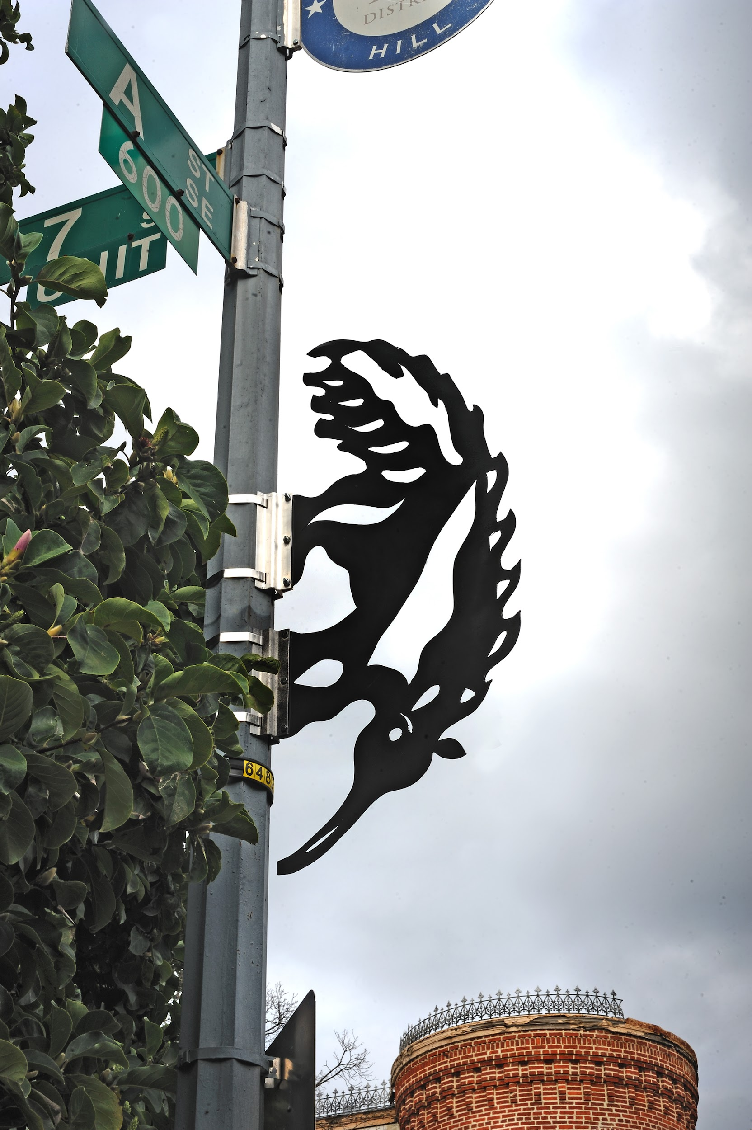
AWESOME ANTEATER!
By Beth Baldwin-Voas
A & 7th St. SE (Dibond)
Photo Credit: Greg Staley
Notes:
-genuinely loves anteaters - note they are not the same as aardvarks!
-note the holes to let the wind through

Slide 31
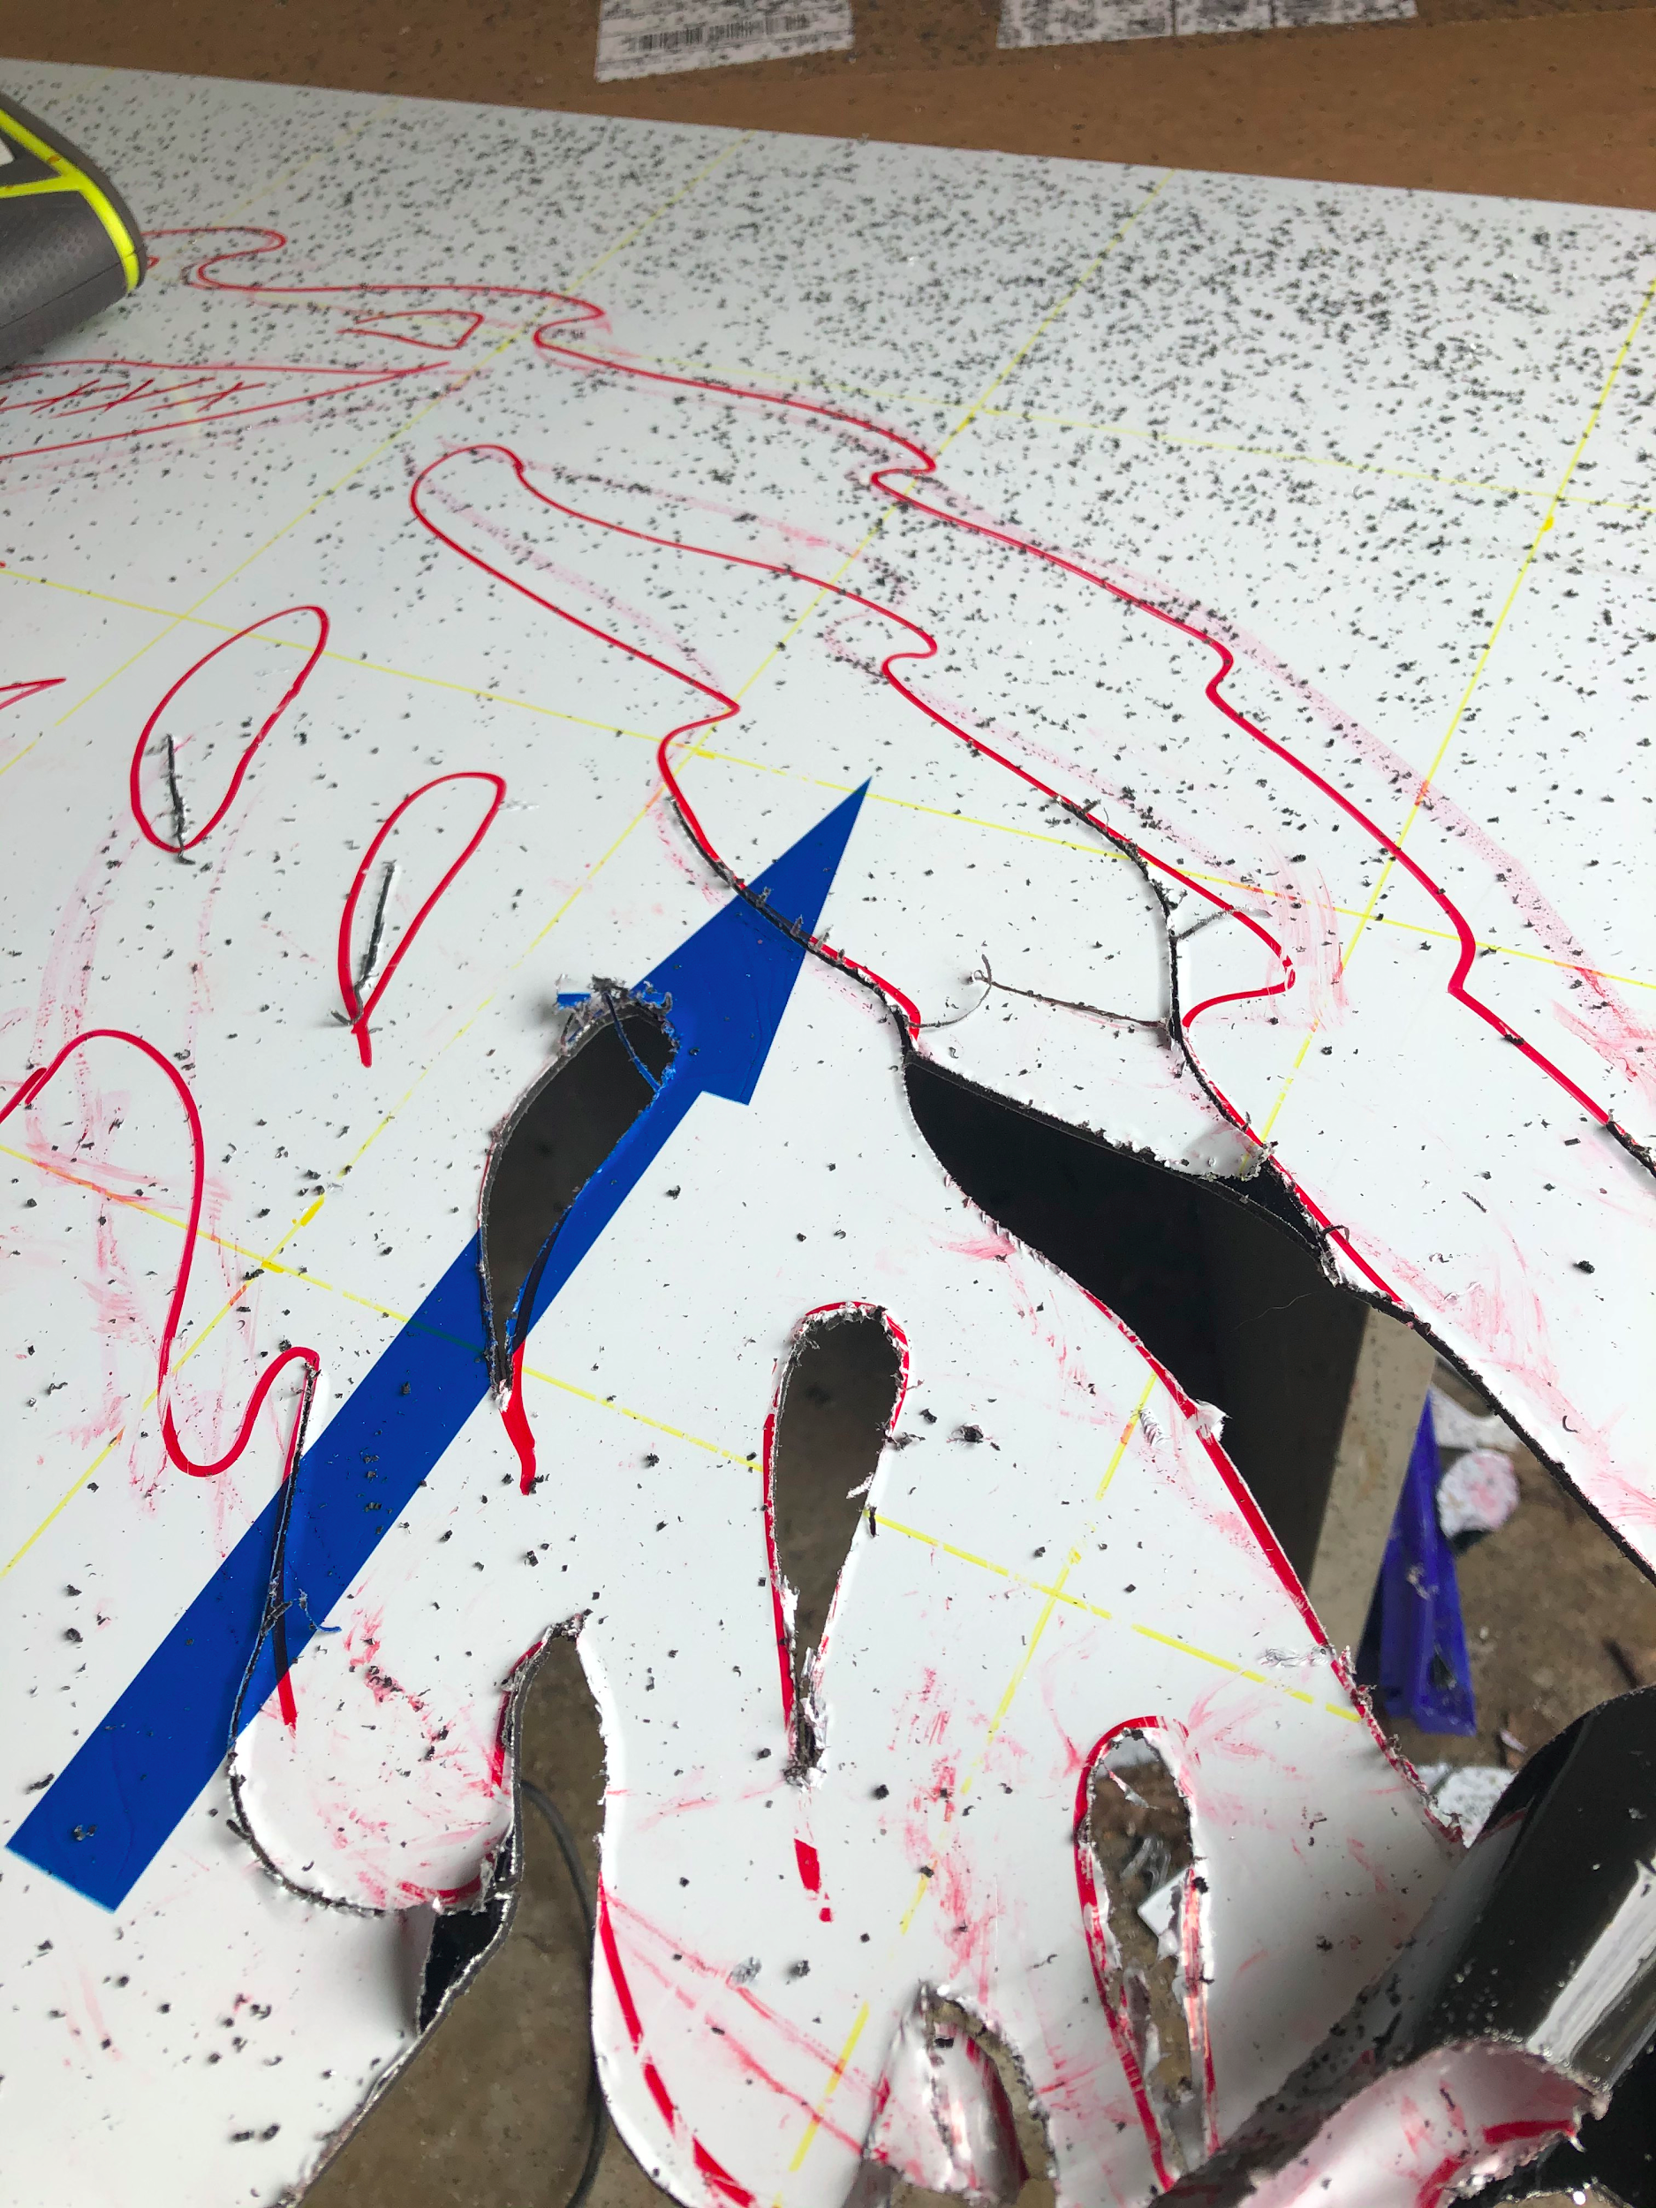
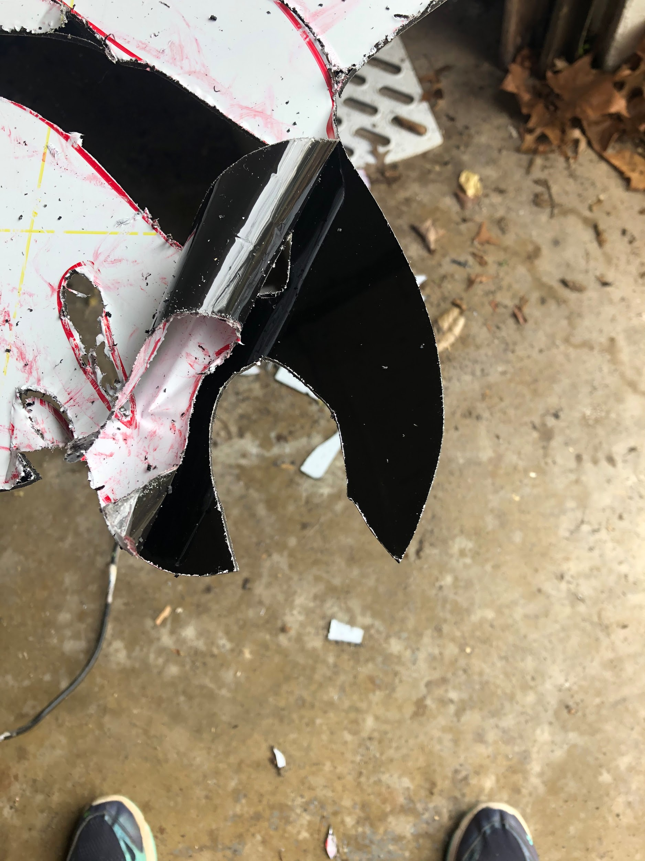
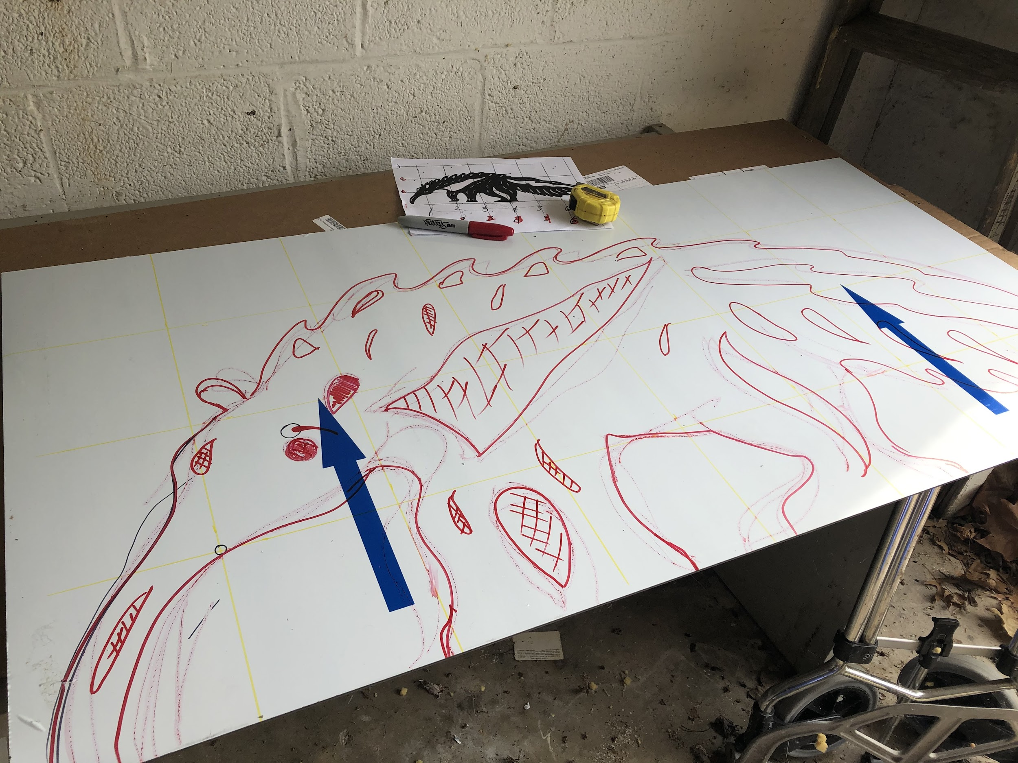
Anteater in process: Beth Baldwin

Slide 32
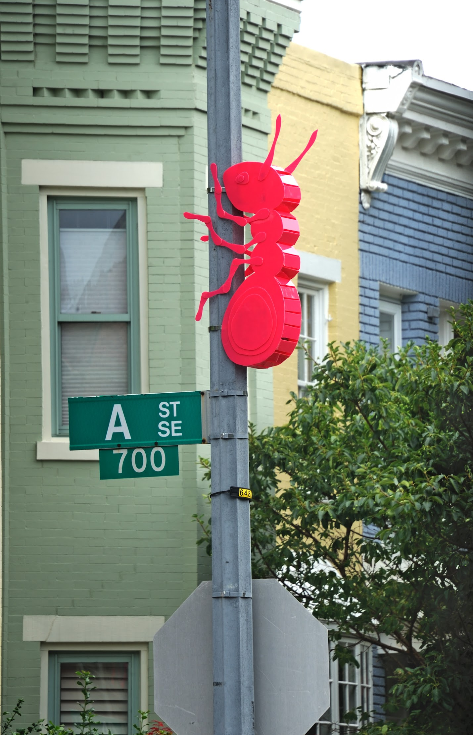
(EMBELLISHED NEIGHBOR)
By Carolina Mayorga
A & 7th St. SE (Acrylic)
Photo Credit: Greg Staley
Notes:
-Pass to Carolina

Slide 33
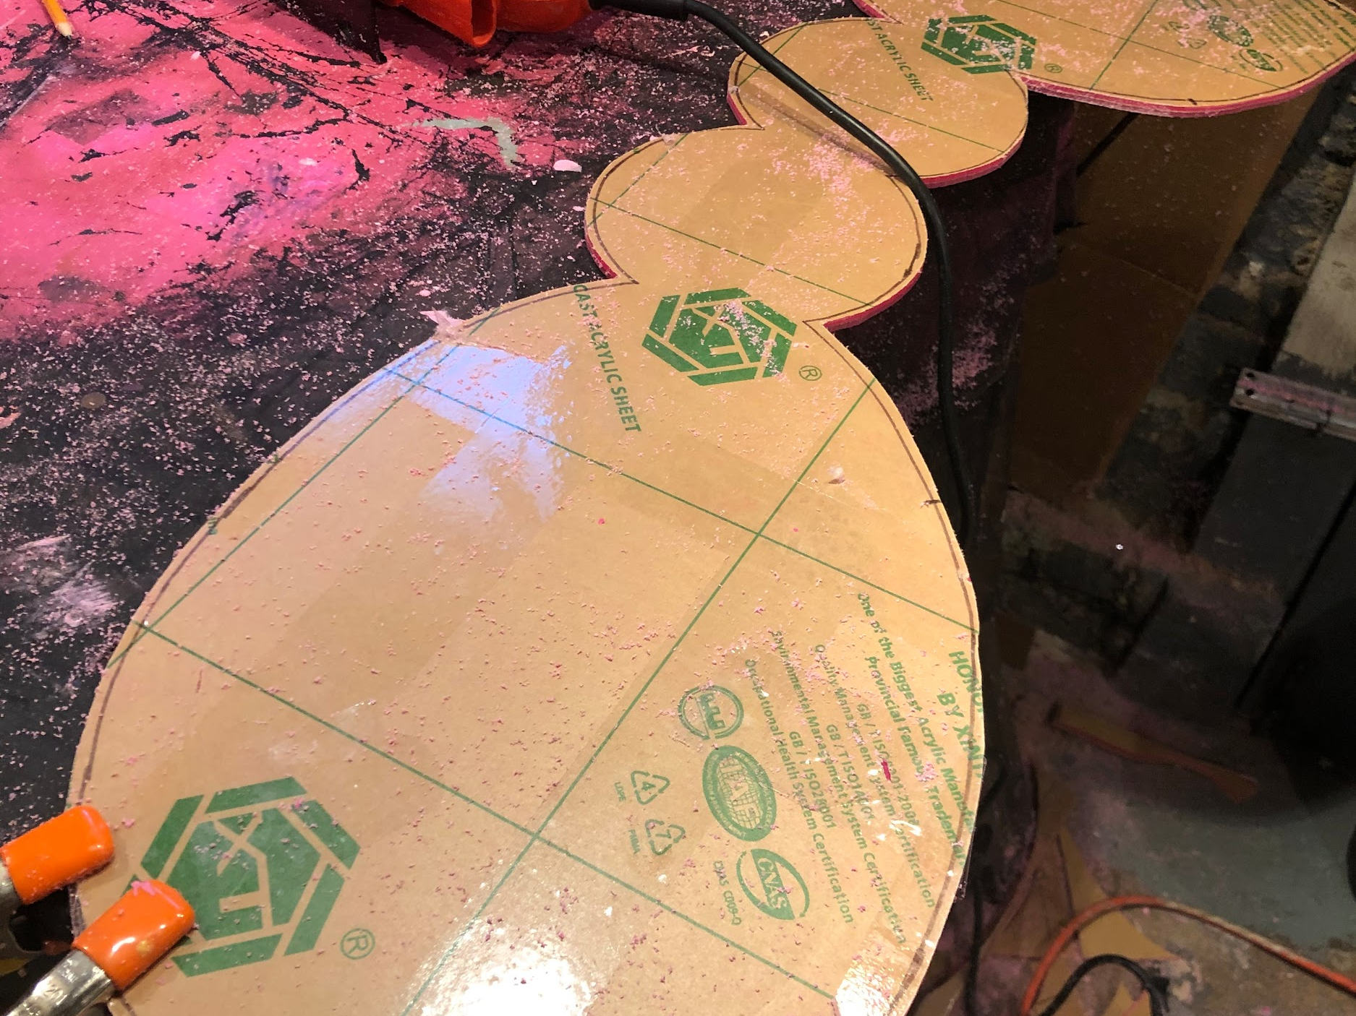
Ant in process: Carolina Mayorga

Slide 34
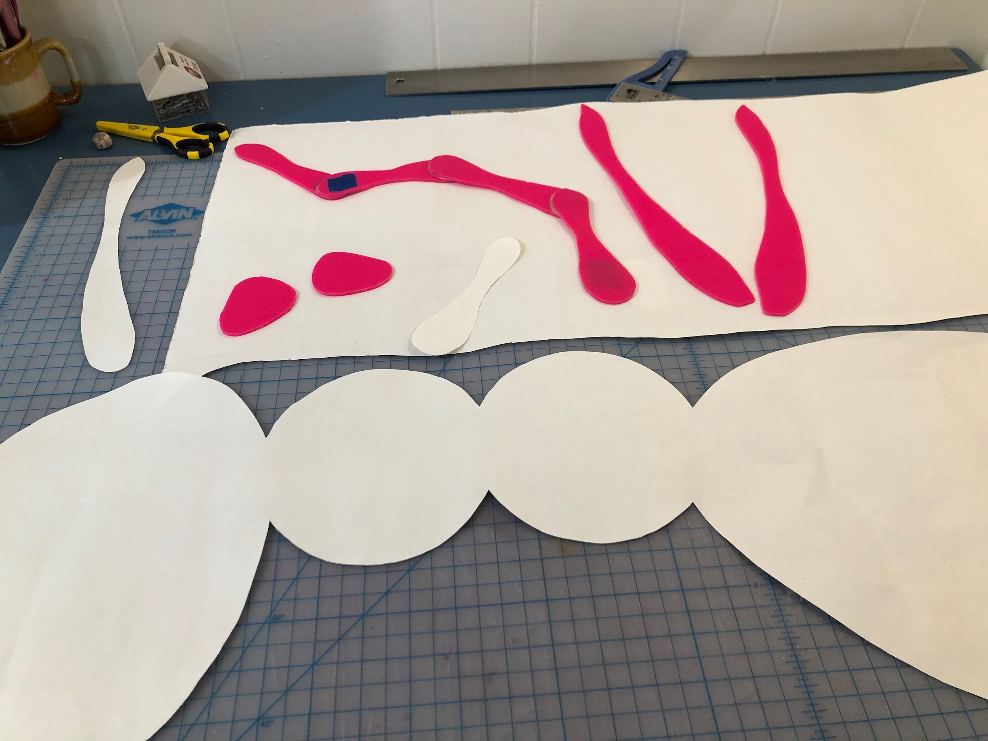
Ant in process: Carolina Mayorga

Slide 35
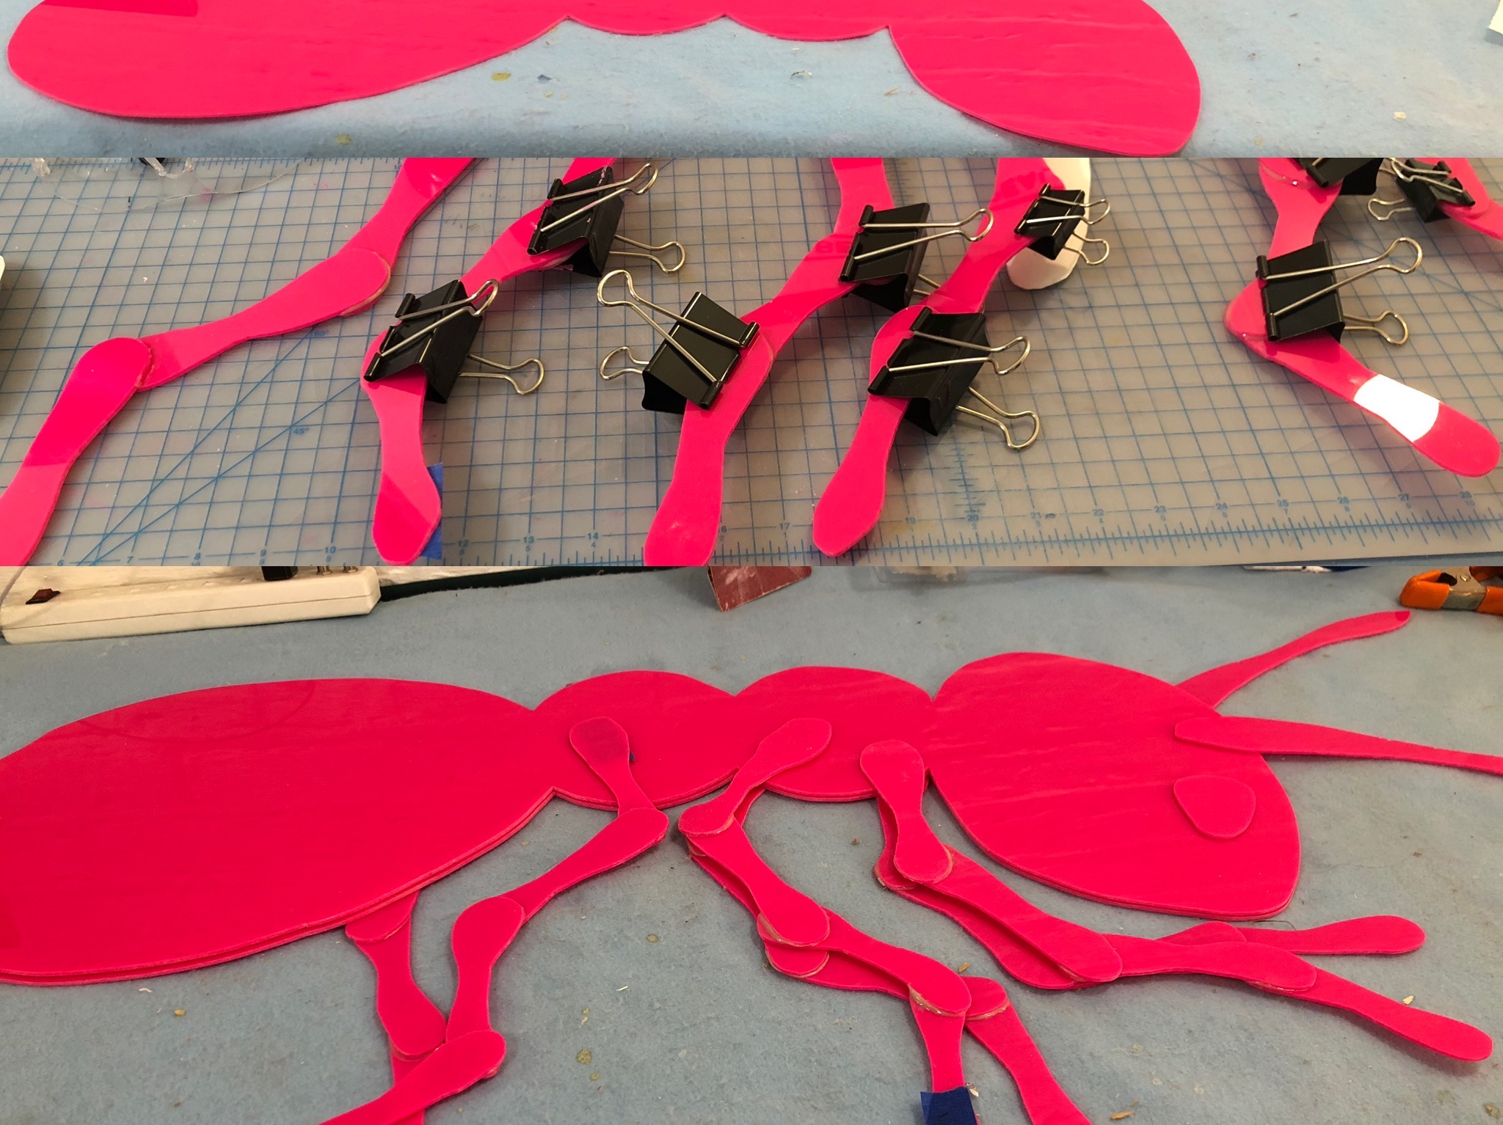
Ant in process: Carolina Mayorga

Slide 36
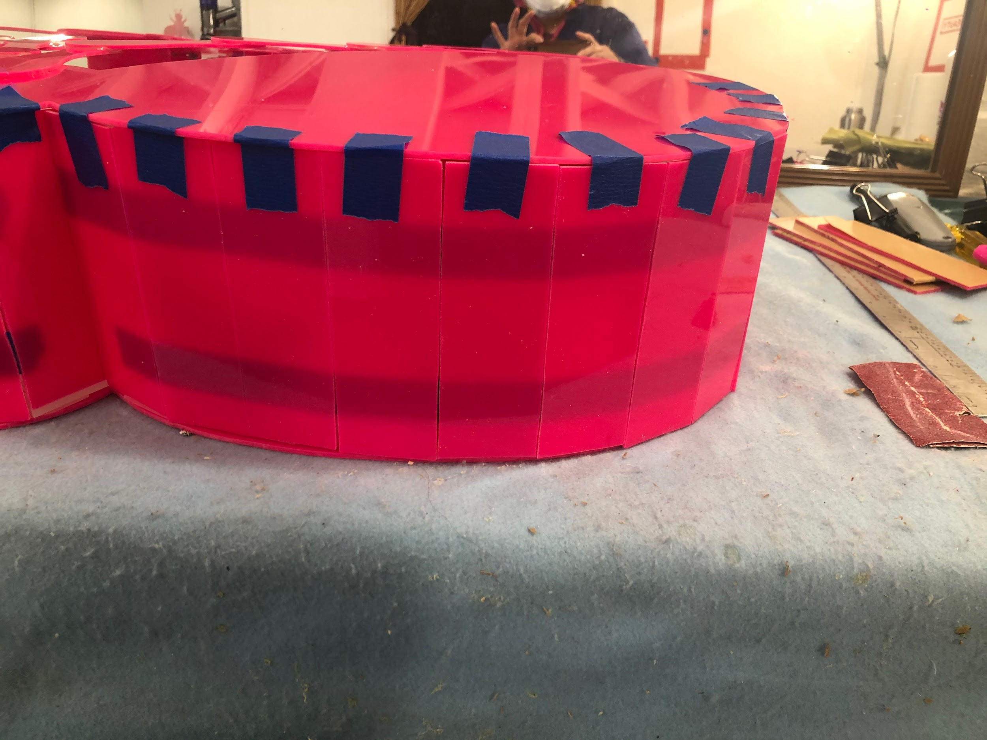
Ant in process: Carolina Mayorga

Slide 37
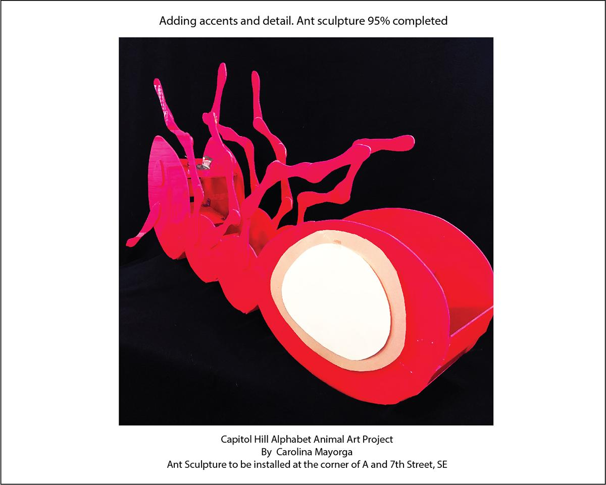
Ant in process: Carolina Mayorga

Slide 38
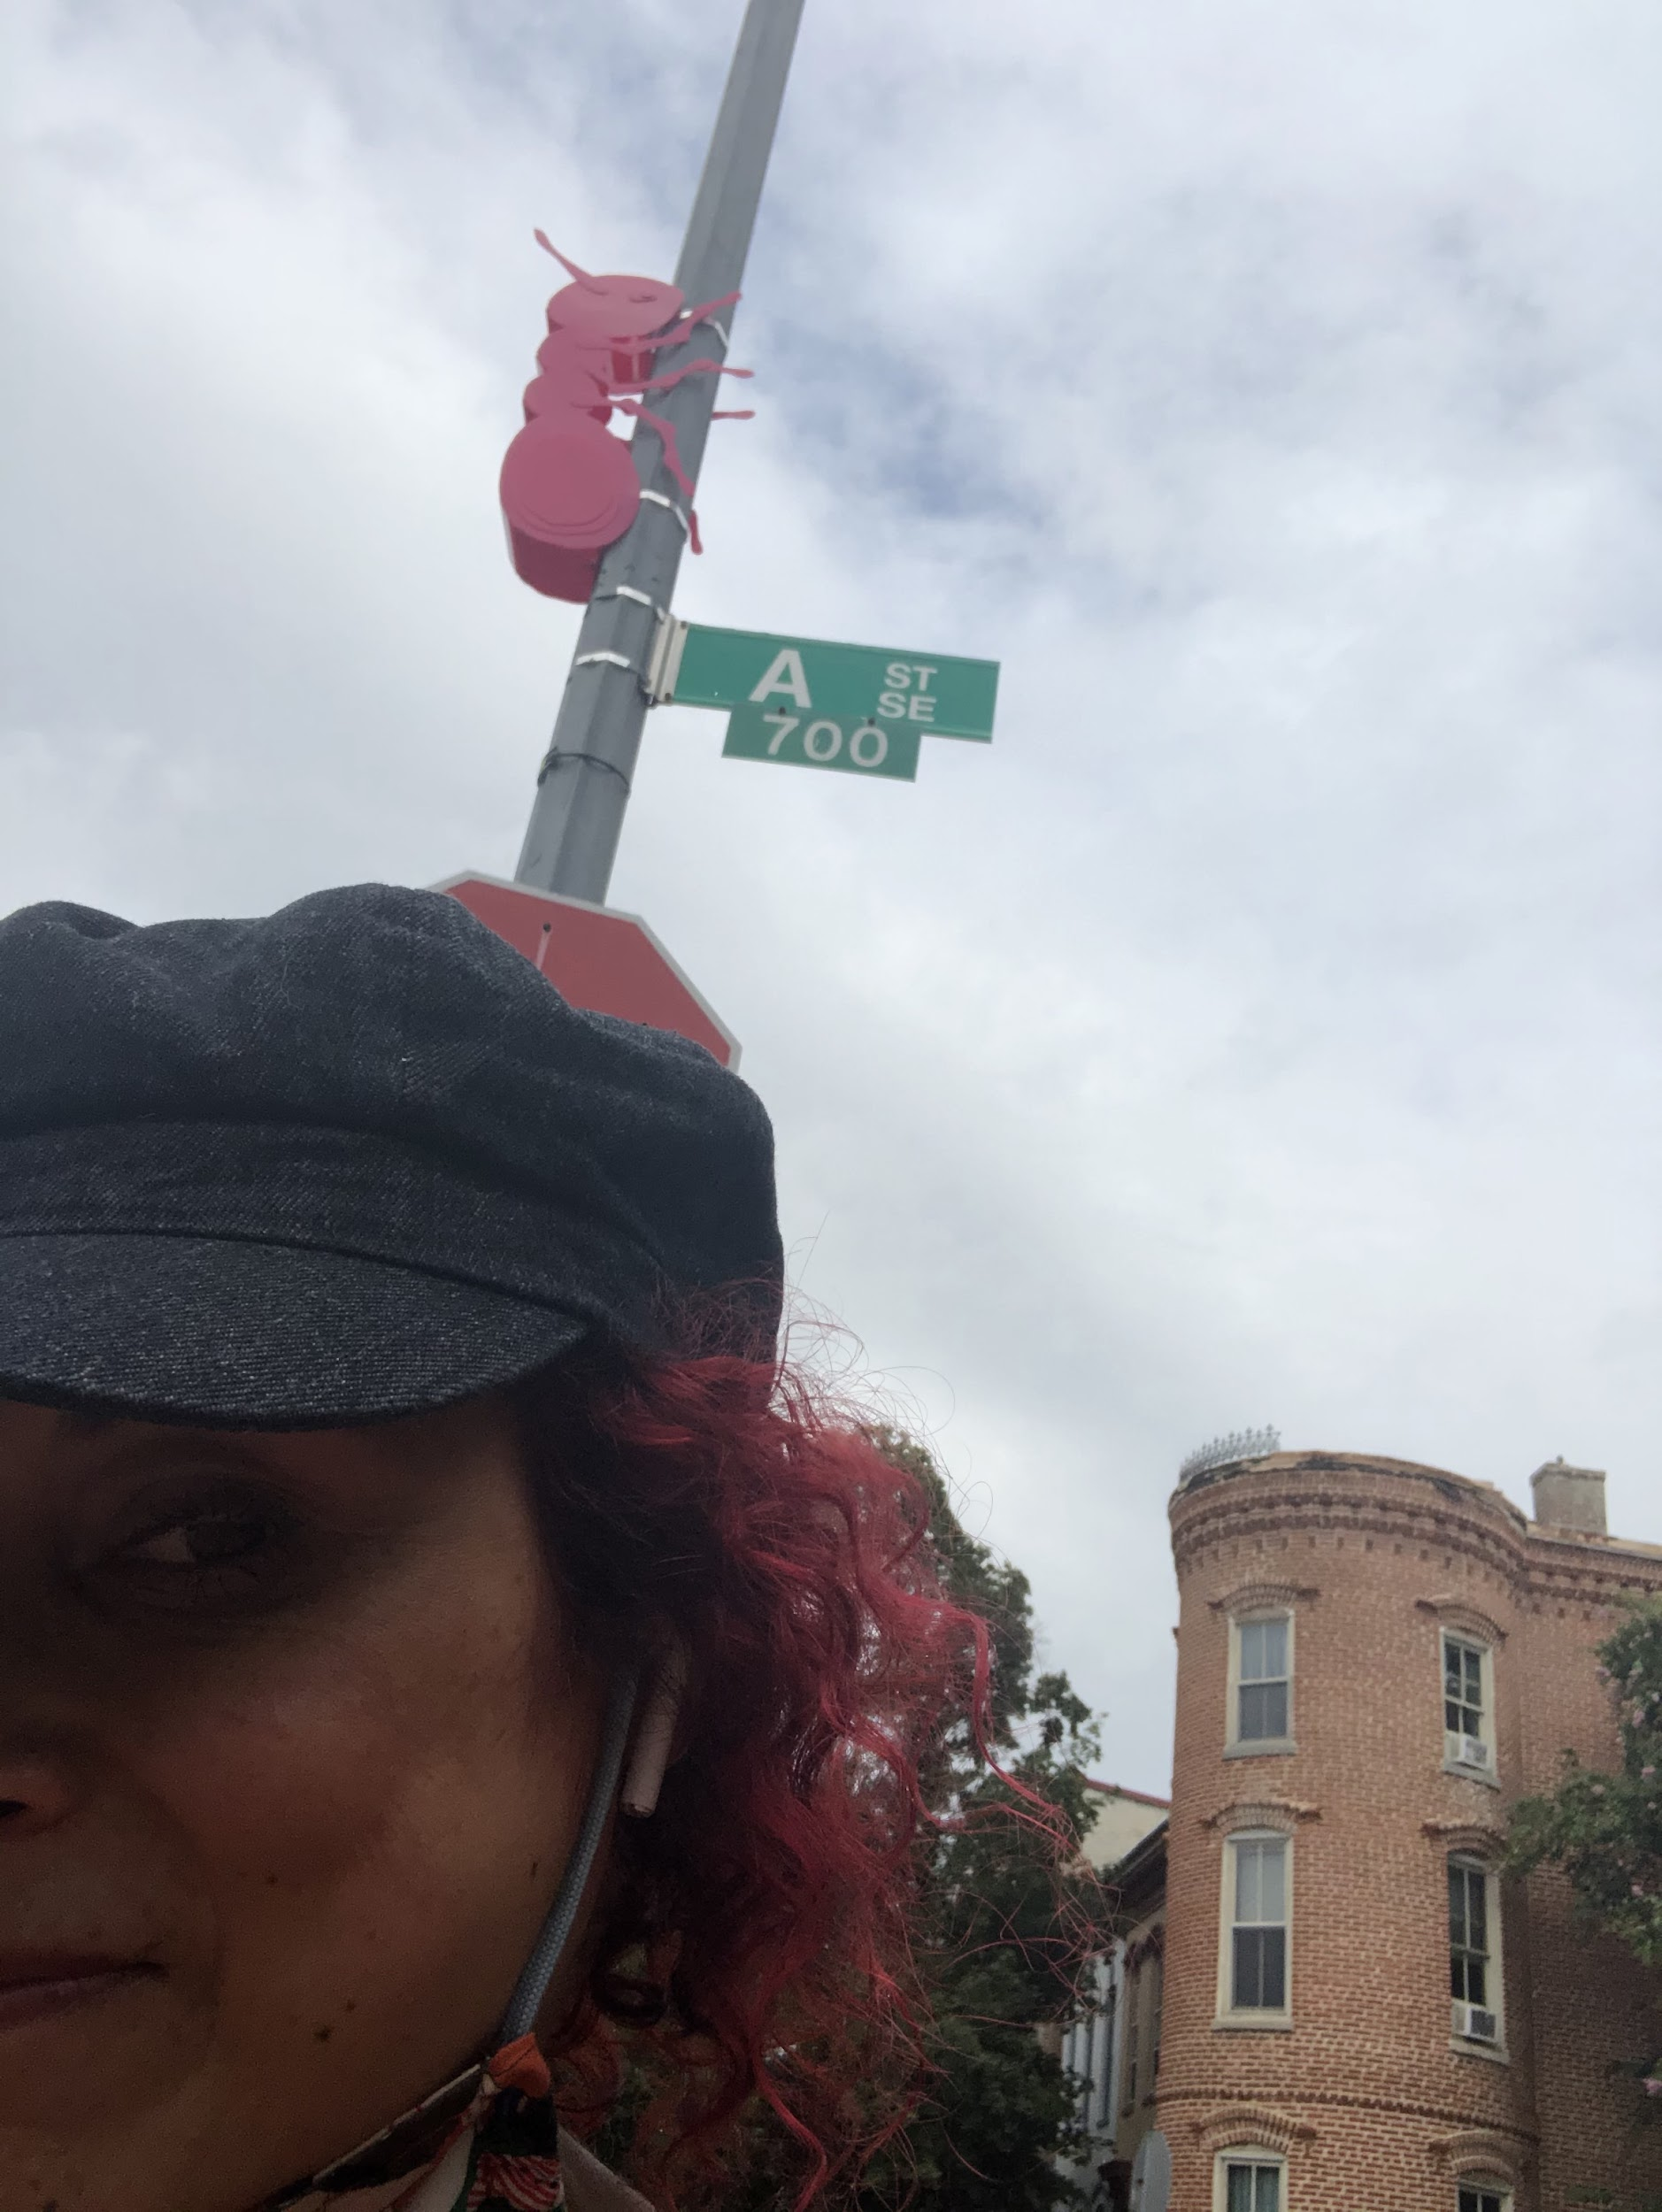
Ant in the wild: Carolina Mayorga

Slide 39
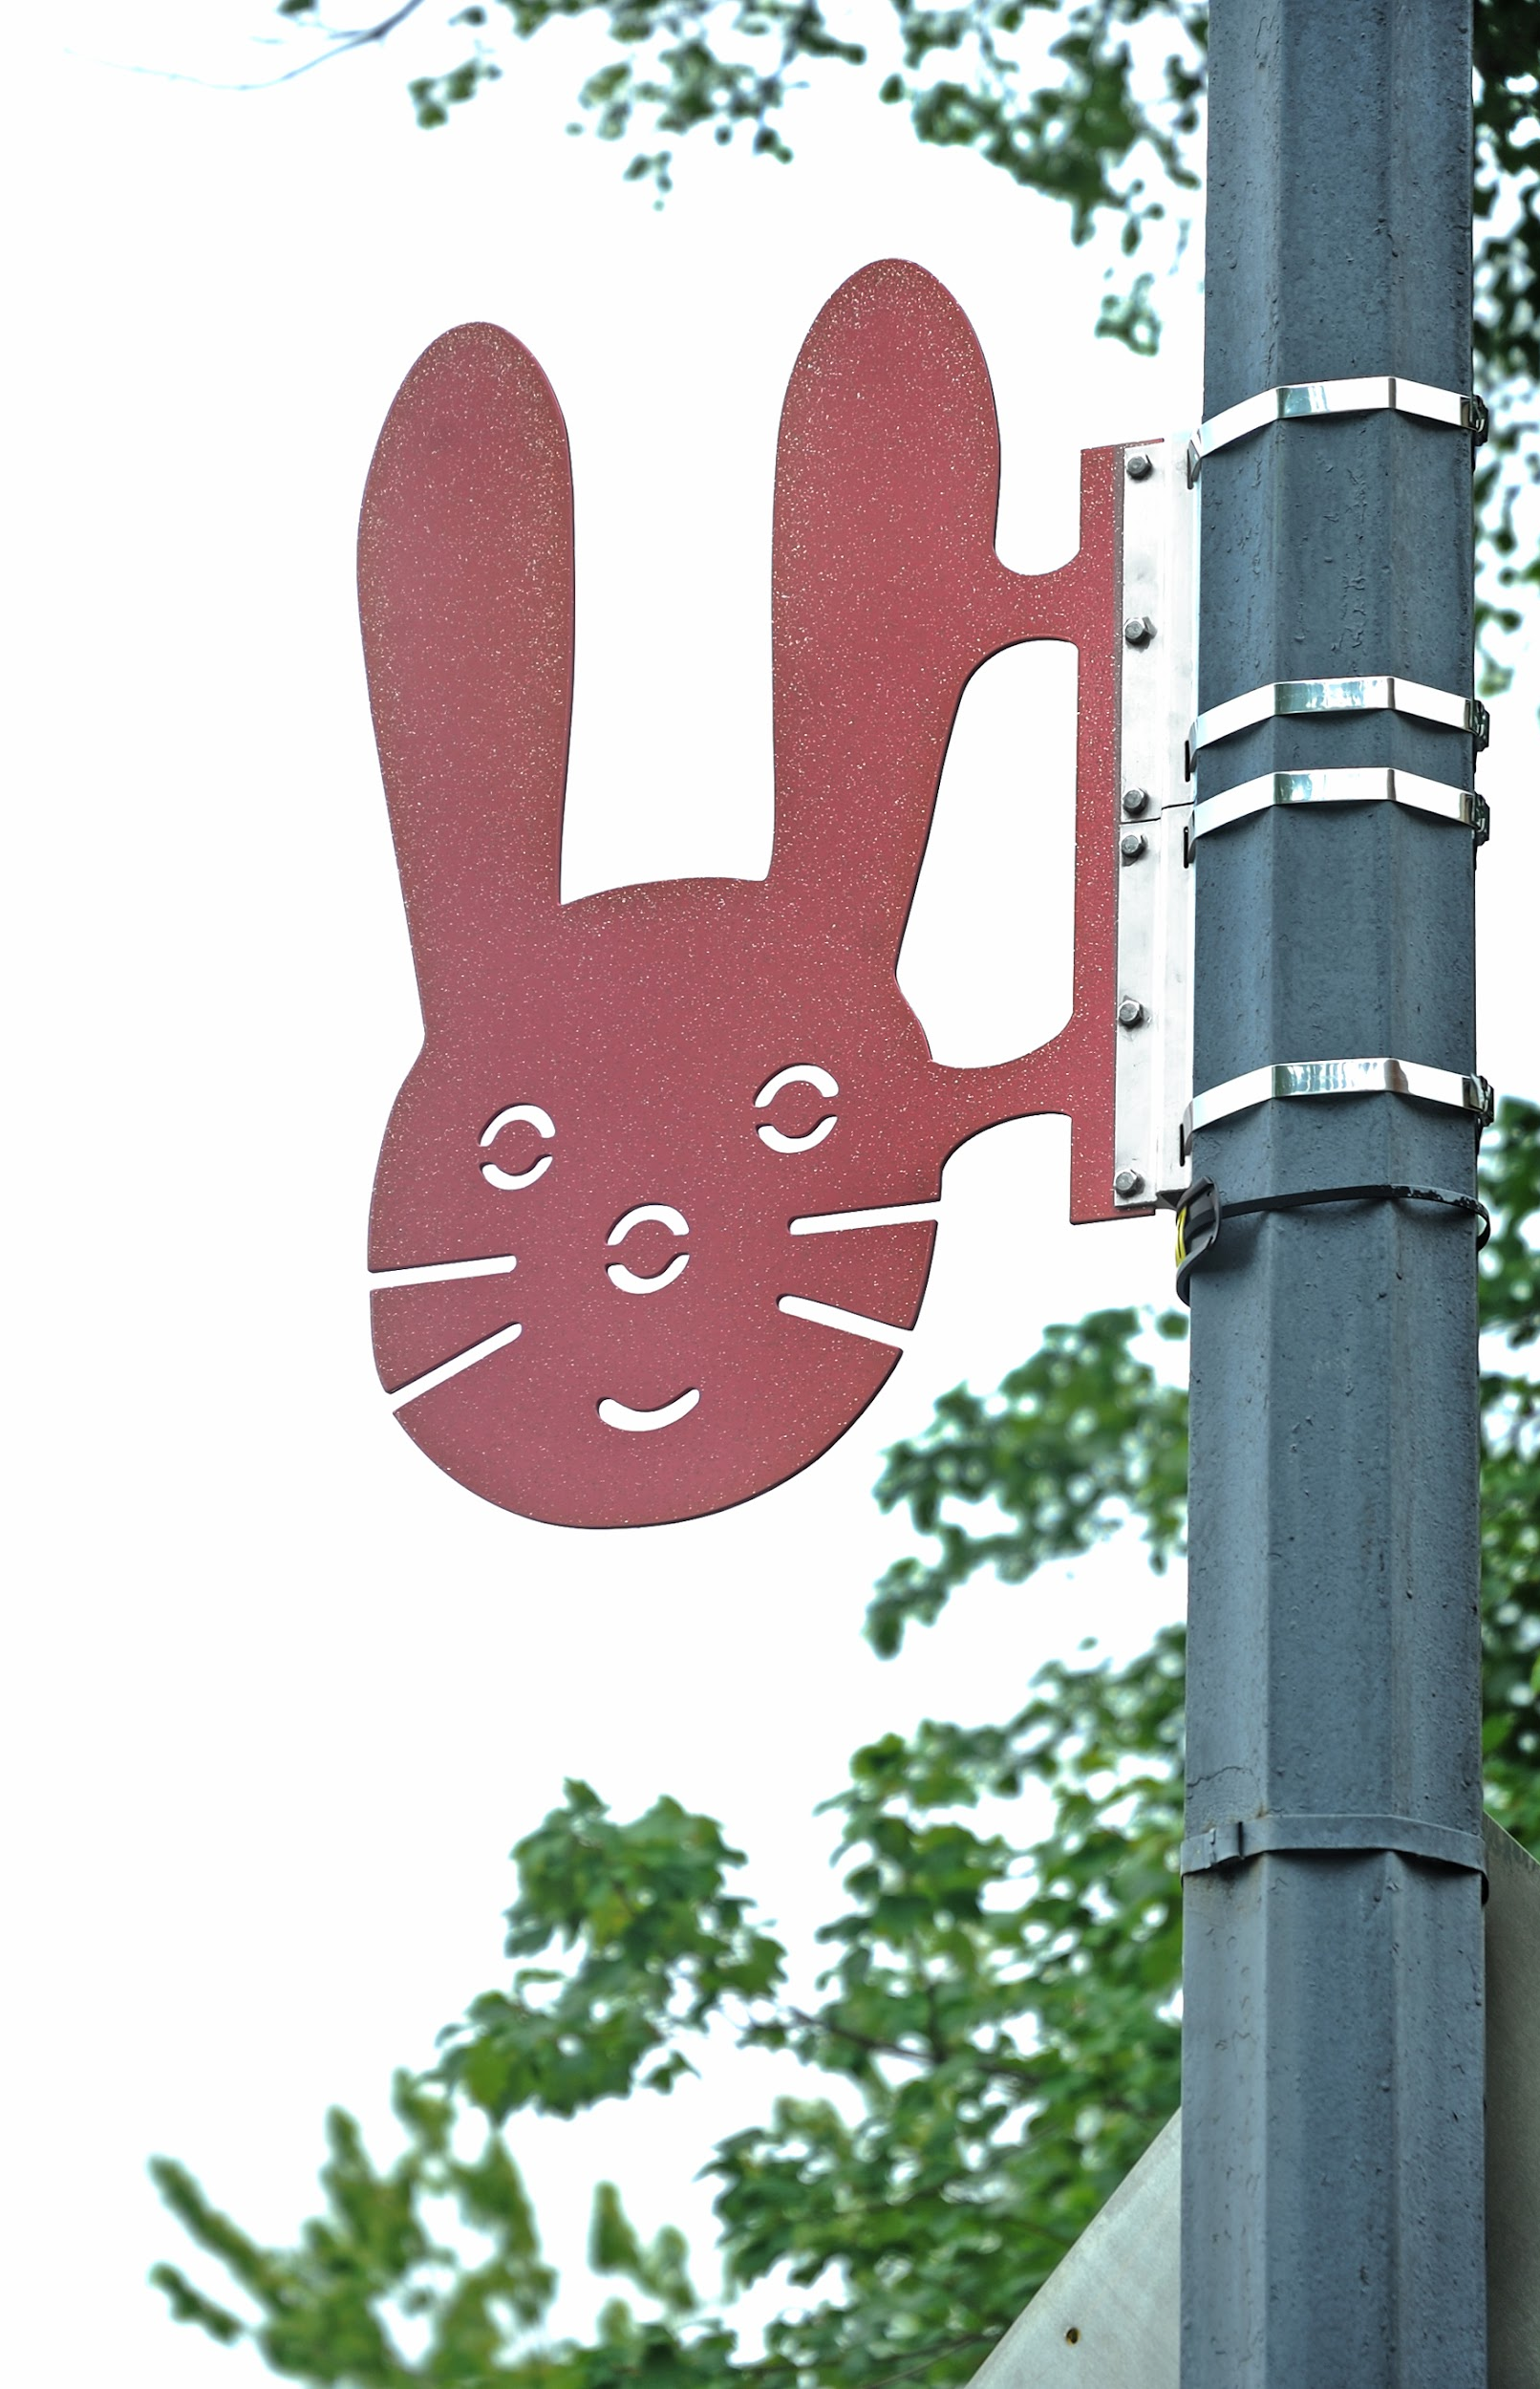
BUNNY
By the artist team of Breon Gilleran & Mimi Frank
Browns Court & 6th St. SE (Powder coated aluminum)
Photo Credit: Greg Staley
Notes:
-ask about how they abandoned the original plan because of weight of art
-recognizable icons

Slide 40
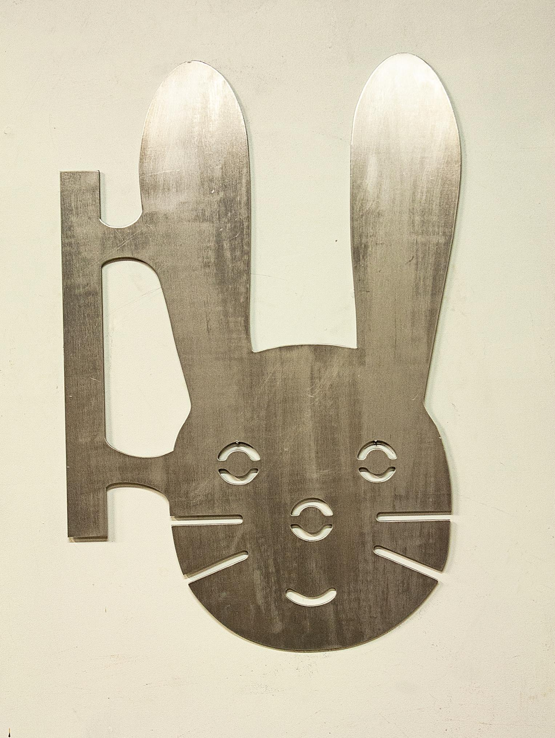
Bunny in process: Breon Gilleran & Mimi Frank

Slide 41
Visit the Animals online: https://www.chaw.org/capitol-hill-alphabet-animal-art-project/

Slide 42
THANK YOU!
Get in touch:
amy@chaw.org hannah@chaw.org

